Slide 1

Computing Option Derivatives by Kernel Smoothing Technique
Sarab Monga
Master of Science, Monash University 2020
&
Brishav Hazarika
Master of Science, Monash University 2020
Notes:
>Good afternoon everyone. My name is Sarab Monga and my group member’s name is Brishav Hazarika.
>Today we will be showing a small presentation on our thesis report called “Computing Option Derivatives by Kernel Smoothing Technique” as a part of our internship unit.
>So let's begin the presentation without further delay.

Slide 2
Introduction
Options are an integral part of hedging strategies, portfolio management and many other facets of the finance industry. And Greeks of an option are used to assess different dimensions of risk involved in taking an options position. Hence, calculation of Greeks is of utmost importance.
In our report, we have implemented techniques called Kernel smoothing and Kernel differentiation, using Monte Carlo simulations, to calculate Delta, Vega, Gamma, Vomma and Vanna, of a European Digital option. European Digital option is a cash or nothing binary option.
The aim of our project is to implement and test this technique using various candidate Kernel functions and change the bandwidth parameter in order to find the best kernel shape and bandwidth for calculating Greeks.
Notes:
>As we all know, options play a very important part in finance. In hedging strategies, portfolio management and many other areas as well. And we know that Greeks of an option are used to measure different dimensions of risk involved in taking an options position. Therefore, calculating the value of these Greeks is fundamental in finance.
>In our project, we have used techniques called Kernel Smoothing and Kernel Differentiation, through Monte Carlo Simulations, to compute five Greeks of a European Digital Option, namely: Delta, Vega, Gamma, Vomma and Vanna. European Digital option is a cash or nothing binary option. This means that the payoff of this option at maturity will be either one or zero.
>Now, Kernel technique involves using various candidate kernel functions. And these functions depend on a parameter called the bandwidth of the Kernel. The aim of our project is to implement and test this technique using various candidate Kernel functions and vary the value of the underlying bandwidth parameter, in order to find the best kernel shape and bandwidth for calculating Greeks.

Slide 3
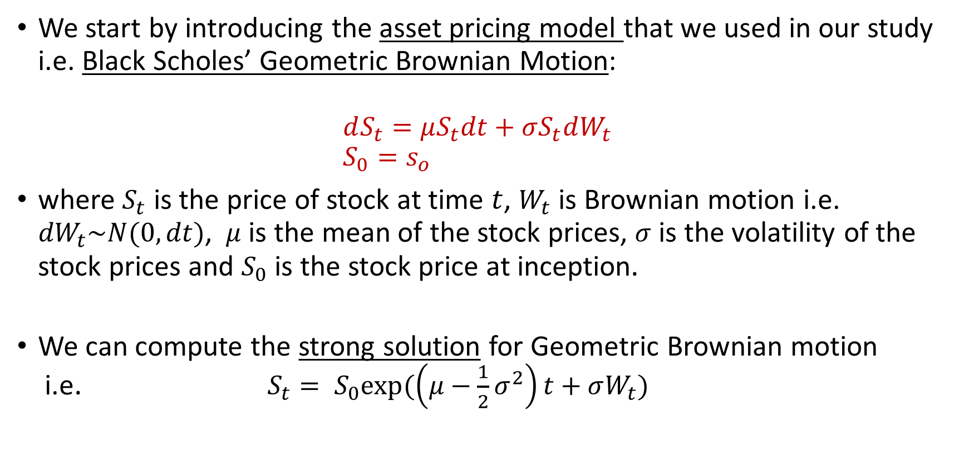
The Asset Model
We start by introducing the asset pricing model that we used in our study i.e. Black Scholes’ Geometric Brownian Motion: $dS_{t}=μS_{t}dt+σS_{t}dW_{t}$ $S_{0}=s_{o}$
where $S_{t}$ is the price of stock at time $t$, $W_{t}$ is Brownian motion i.e. ${dW}_{t}\sim N(0,dt)$, $μ$ is the mean of the stock prices, $σ$ is the volatility of the stock prices and $S_{0}$ is the stock price at inception.
We can compute the strong solution for Geometric Brownian motion i.e. $S_{t}= S_{0}exp(\left(μ−\frac{1}{2}σ^{2}\right)t+σW_{t})$

Slide 4
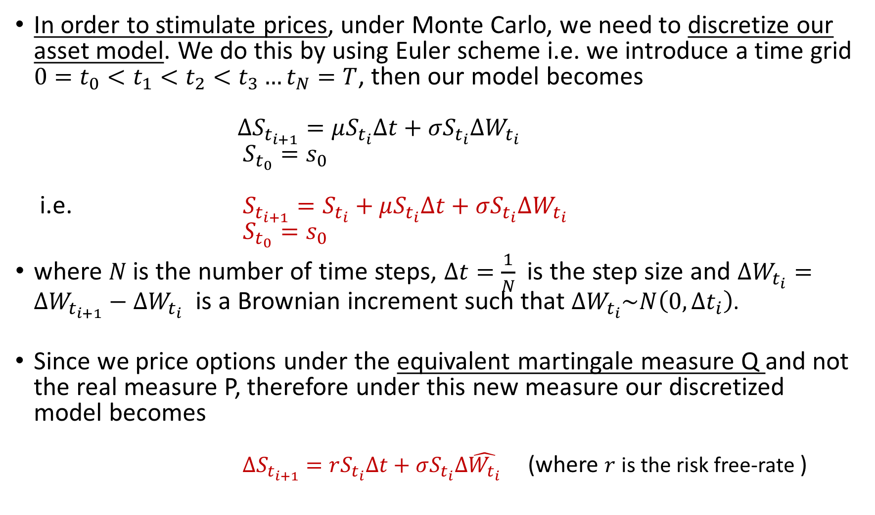
In order to stimulate prices, under Monte Carlo, we need to discretize our asset model. We do this by using Euler scheme i.e. we introduce a time grid $0=t_{0}<t_{1}<t_{2}<t_{3}…t_{N}=T$, then our model becomes $∆S_{t_{i+1}}=μS_{t_{i}}∆t+σS_{t_{i}}∆W_{t_{i}}$ $S_{t_{0}}=s_{0}$ i.e. $S_{t_{i+1}}=S_{t_{i}}+μS_{t_{i}}∆t+σS_{t_{i}}∆W_{t_{i}}$ $S_{t_{0}}=s_{0}$
where $N$is the number of time steps, $∆t=\frac{1}{N}$ is the step size and $∆W_{t_{i}}=∆W_{t_{i+1}}−∆W_{t_{i}}$ is a Brownian increment such that $∆W_{t_{i}}\sim N\left(0,∆t_{i}\right)$.
Since we price options under the equivalent martingale measure Q and not the real measure P, therefore under this new measure our discretized model becomes $∆S_{t_{i+1}}=rS_{t_{i}}∆t+σS_{t_{i}}∆\hat{W_{t_{i}}}$ (where $r$ is the risk free-rate )

Slide 5
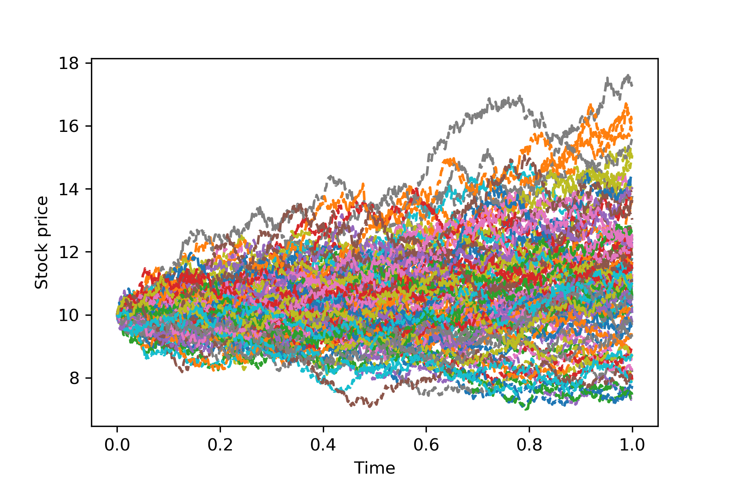
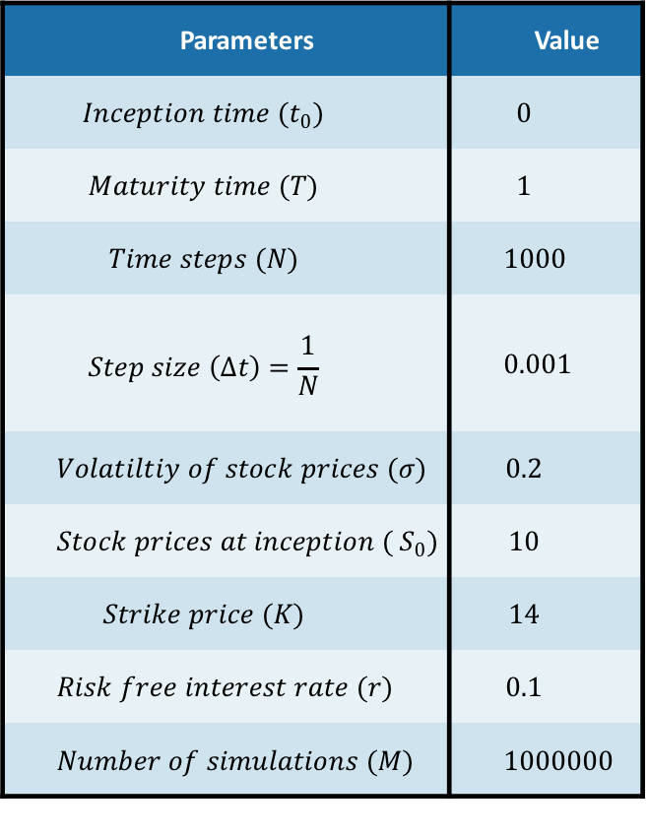
The above model is then used to generate M simulations, via Monte Carlo, by using the following parameters:
Parameters | Value
$$Inception time (t_{0})$$ | $$0$$
$$Maturity time (T)$$ | $$1$$
$$Time steps (N)$$ | $$1000$$
$$Step size \left(∆t\right)=\frac{1}{N}$$ | $$0.001$$
$$Volatiltiy of stock prices (σ)$$ | $$0.2$$
$$Stock prices at inception ({ S}_{0})$$ | $$10$$
$$Strike price (K)$$ | $$14$$
$$Risk free interest rate (r)$$ | $$0.1$$
$$Number of simulations (M)$$ | $$1000000$$

Slide 6
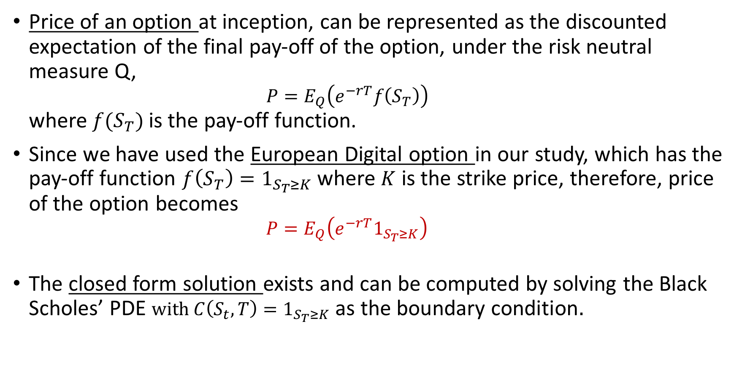
Options
Price of an option at inception, can be represented as the discounted expectation of the final pay-off of the option, under the risk neutral measure Q, $P=E_{Q}\left(e^{−rT}f\left(S_{T}\right)\right)$ where $f(S_{T})$ is the pay-off function.
Since we have used the European Digital option in our study, which has the pay-off function $f\left(S_{T}\right)=1_{S_{T}≥K}$ where $K$ is the strike price, therefore, price of the option becomes $P=E_{Q}\left(e^{−rT}1_{S_{T}≥K}\right)$
The closed form solution exists and can be computed by solving the Black Scholes’ PDE $with{ C\left(S_{t},T\right)=1}_{S_{T}≥K}$ $\text{as} \text{the} \text{boundary} \text{condition}.$

Slide 7
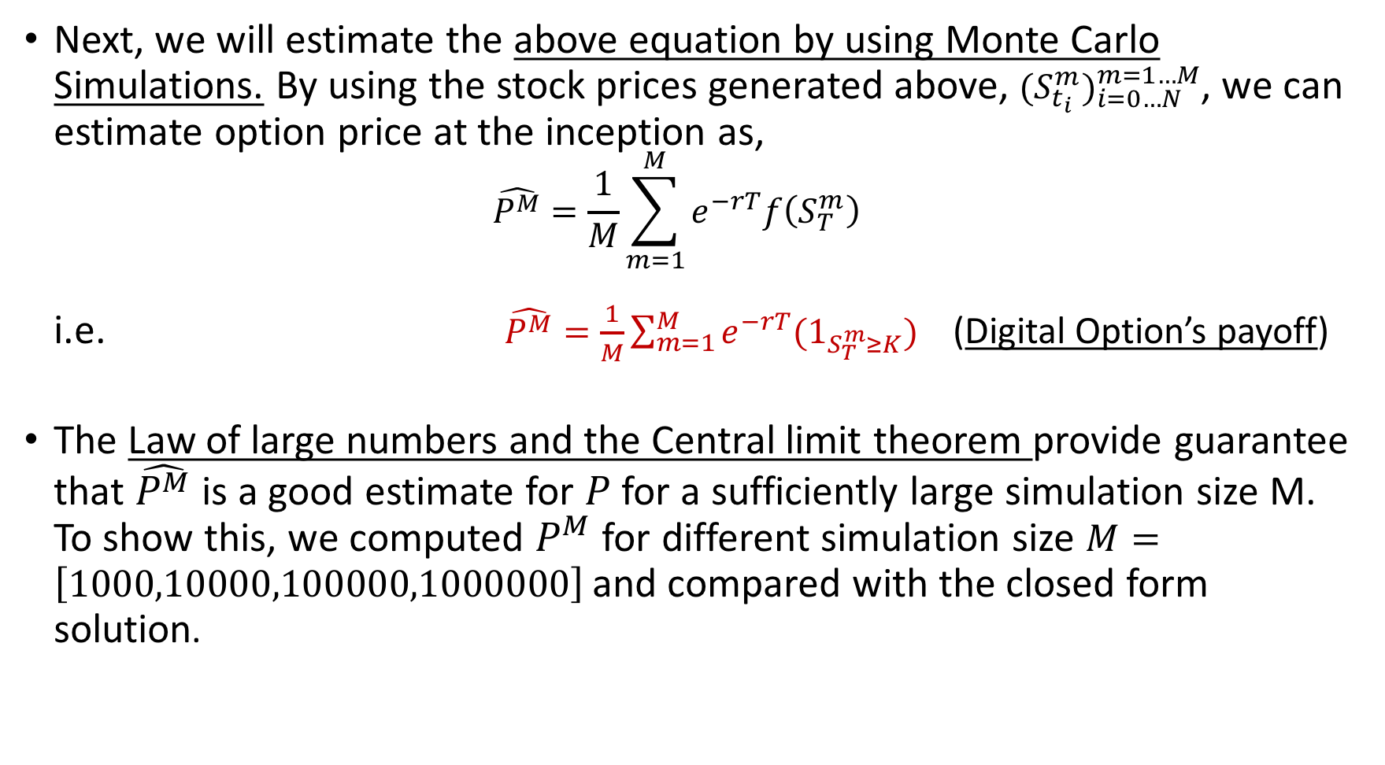
Next, we will estimate the above equation by using Monte Carlo Simulations. By using the stock prices generated above, ${(S_{t_{i}}^{m})}_{i=0…N}^{m=1…M}$, we can estimate option price at the inception as, $\hat{P^{M}}=\frac{1}{M}\sum_{m=1}^{M}{e^{−rT}f\left(S_{T}^{m}\right)}$ i.e. $\hat{P^{M}}=\frac{1}{M}\sum_{m=1}^{M}{e^{−rT}{(1}_{S_{T}^{m}≥K})}$ (Digital Option’s payoff)
The Law of large numbers and the Central limit theorem provide guarantee that $\hat{P^{M}}$ is a good estimate for $P$ for a sufficiently large simulation size M. To show this, we computed $P^{M}$ for different simulation size $M=\left[1000,10000,100000,1000000\right]$and compared with the closed form solution.

Slide 8
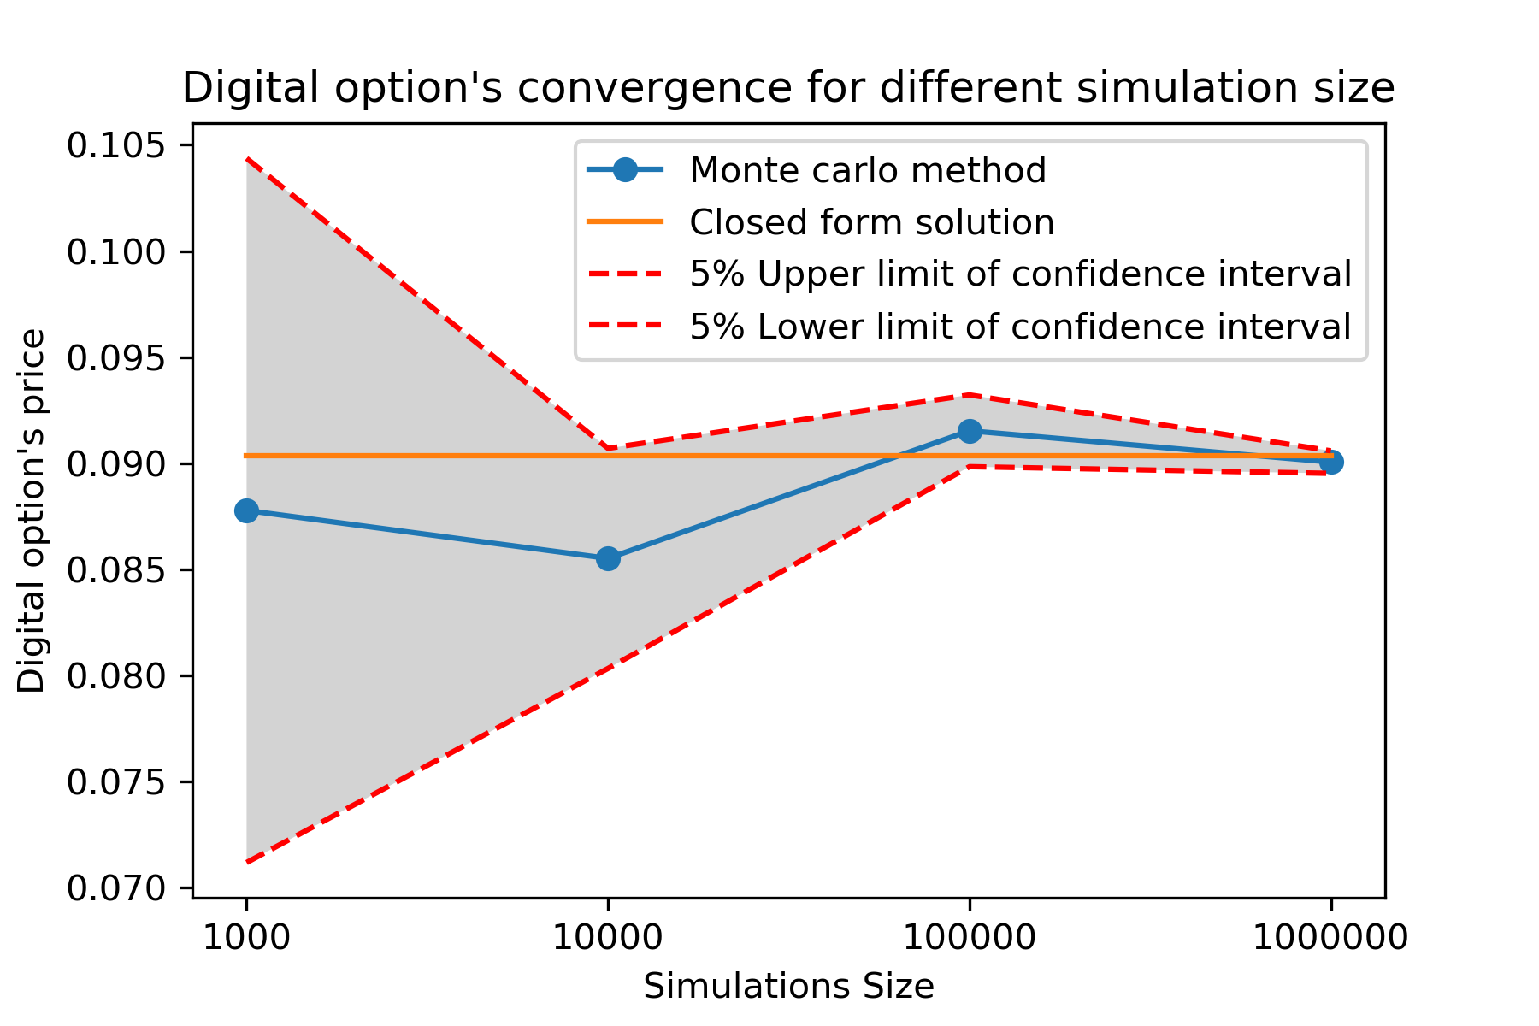
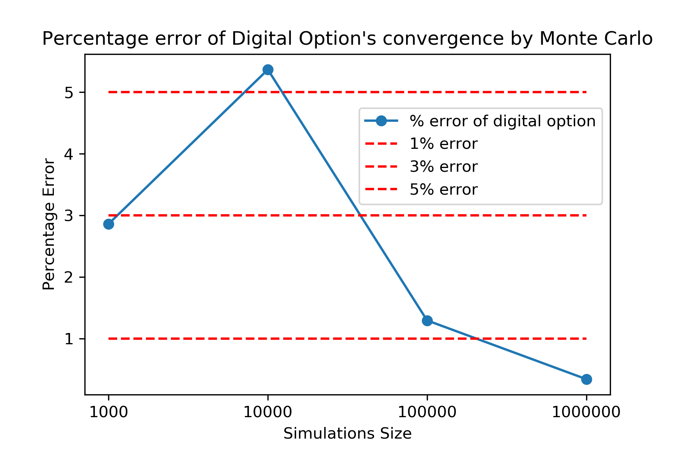
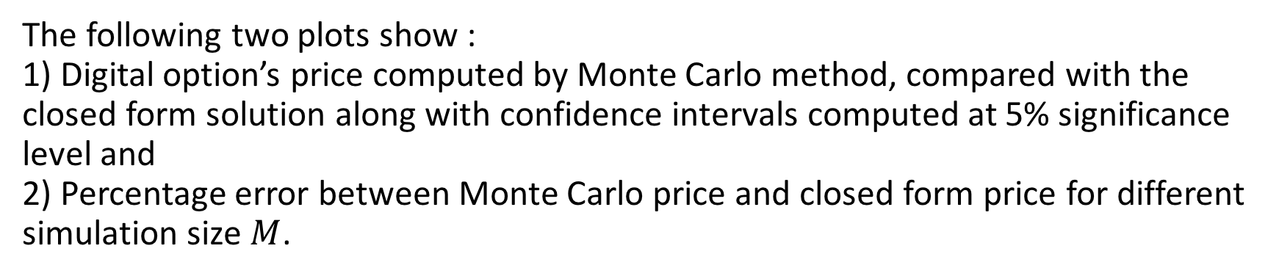
The following two plots show : 1) Digital option’s price computed by Monte Carlo method, compared with the closed form solution along with confidence intervals computed at 5% significance level and 2) Percentage error between Monte Carlo price and closed form price for different simulation size $M$.

Slide 9
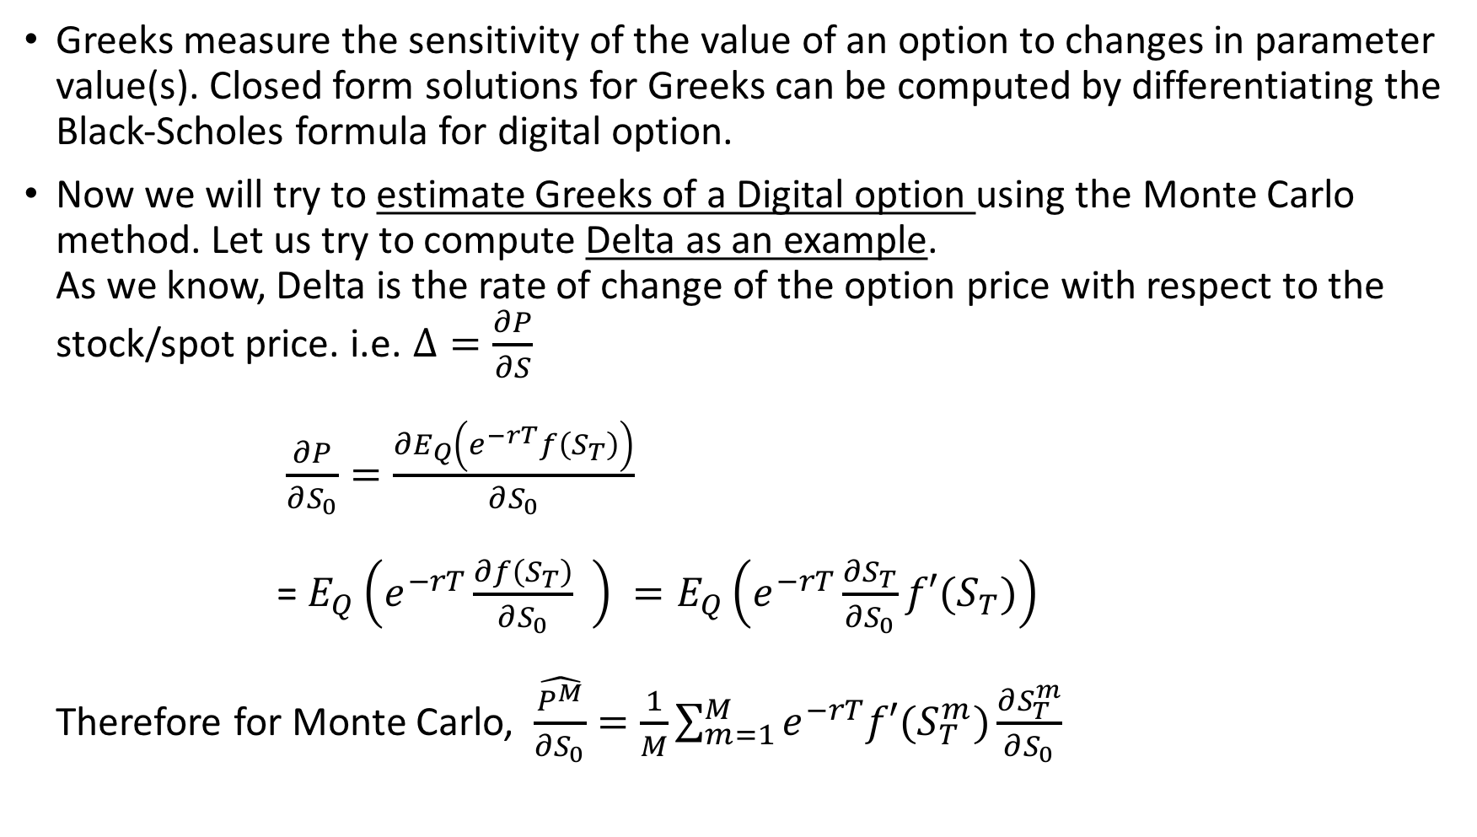
Greeks
Greeks measure the sensitivity of the value of an option to changes in parameter value(s). Closed form solutions for Greeks can be computed by differentiating the Black-Scholes formula for digital option.
Now we will try to estimate Greeks of a Digital option using the Monte Carlo method. Let us try to compute Delta as an example. As we know, Delta is the rate of change of the option price with respect to the stock/spot price. i.e. $Δ=\frac{∂P}{∂S}$ $\frac{∂P}{∂S_{0}}=\frac{∂E_{Q}\left(e^{−rT}f\left(S_{T}\right)\right)}{∂S_{0}}$ = $E_{Q}\left(e^{−rT}\frac{∂f\left(S_{T}\right)}{∂S_{0}} \right) =E_{Q}\left(e^{−rT}\frac{∂S_{T}}{∂S_{0}}f′(S_{T})\right)$ Therefore for Monte Carlo, $\hat{\frac{P^{M}}{∂S_{0}}}=\frac{1}{M}\sum_{m=1}^{M}{e^{−rT}f′(S_{T}^{m})\frac{∂S_{T}^{m}}{∂S_{0}}}$

Slide 10
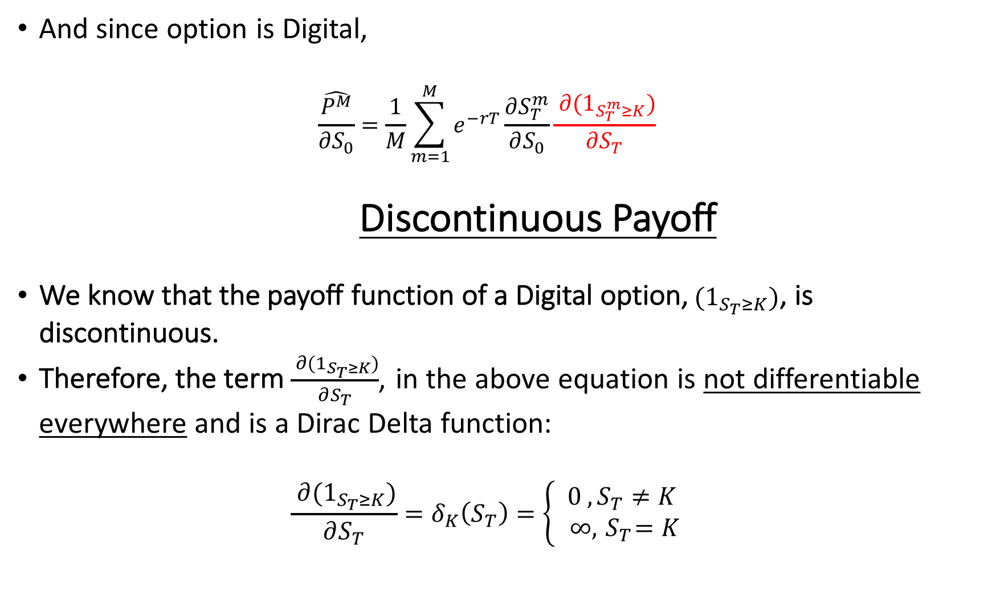
And since option is Digital, $\hat{\frac{P^{M}}{∂S_{0}}}=\frac{1}{M}\sum_{m=1}^{M}{e^{−rT}\frac{∂S_{T}^{m}}{∂S_{0}}\frac{{ ∂(1}_{S_{T}^{m}≥K})}{∂S_{T}} }$ Discontinuous Payoff
We know that the payoff function of a Digital option,${ (1}_{S_{T}≥K})$, is discontinuous.
Therefore, the term $\frac{{ ∂(1}_{S_{T}≥K})}{∂S_{T}}$, in the above equation is not differentiable everywhere and is a Dirac Delta function: $\frac{{ ∂(1}_{S_{T}≥K})}{∂S_{T}}=δ_{K}\left(S_{T}\right)=\left\{\begin{aligned} 0 , S_{T}≠K \\ ∞,{ S}_{T}=K \end{aligned}\right.$

Slide 11
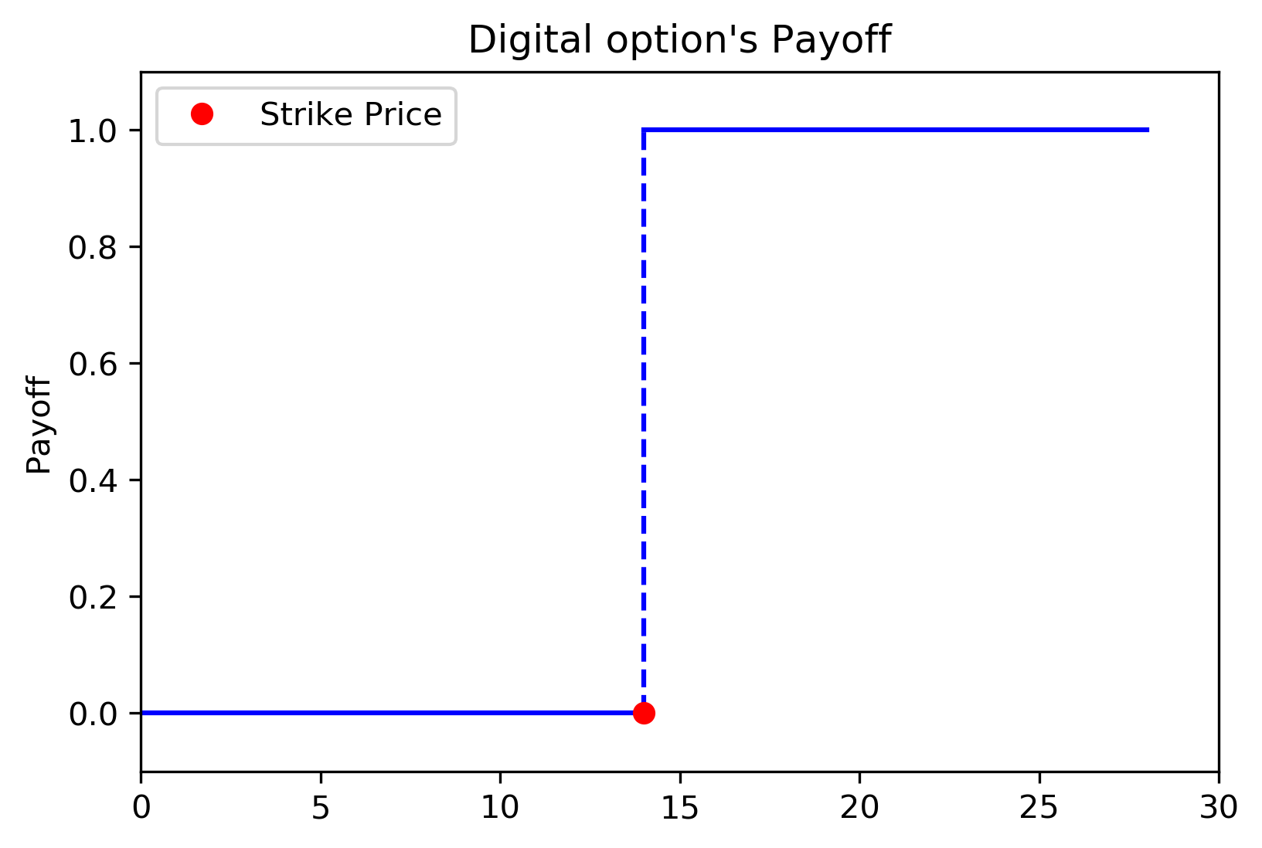
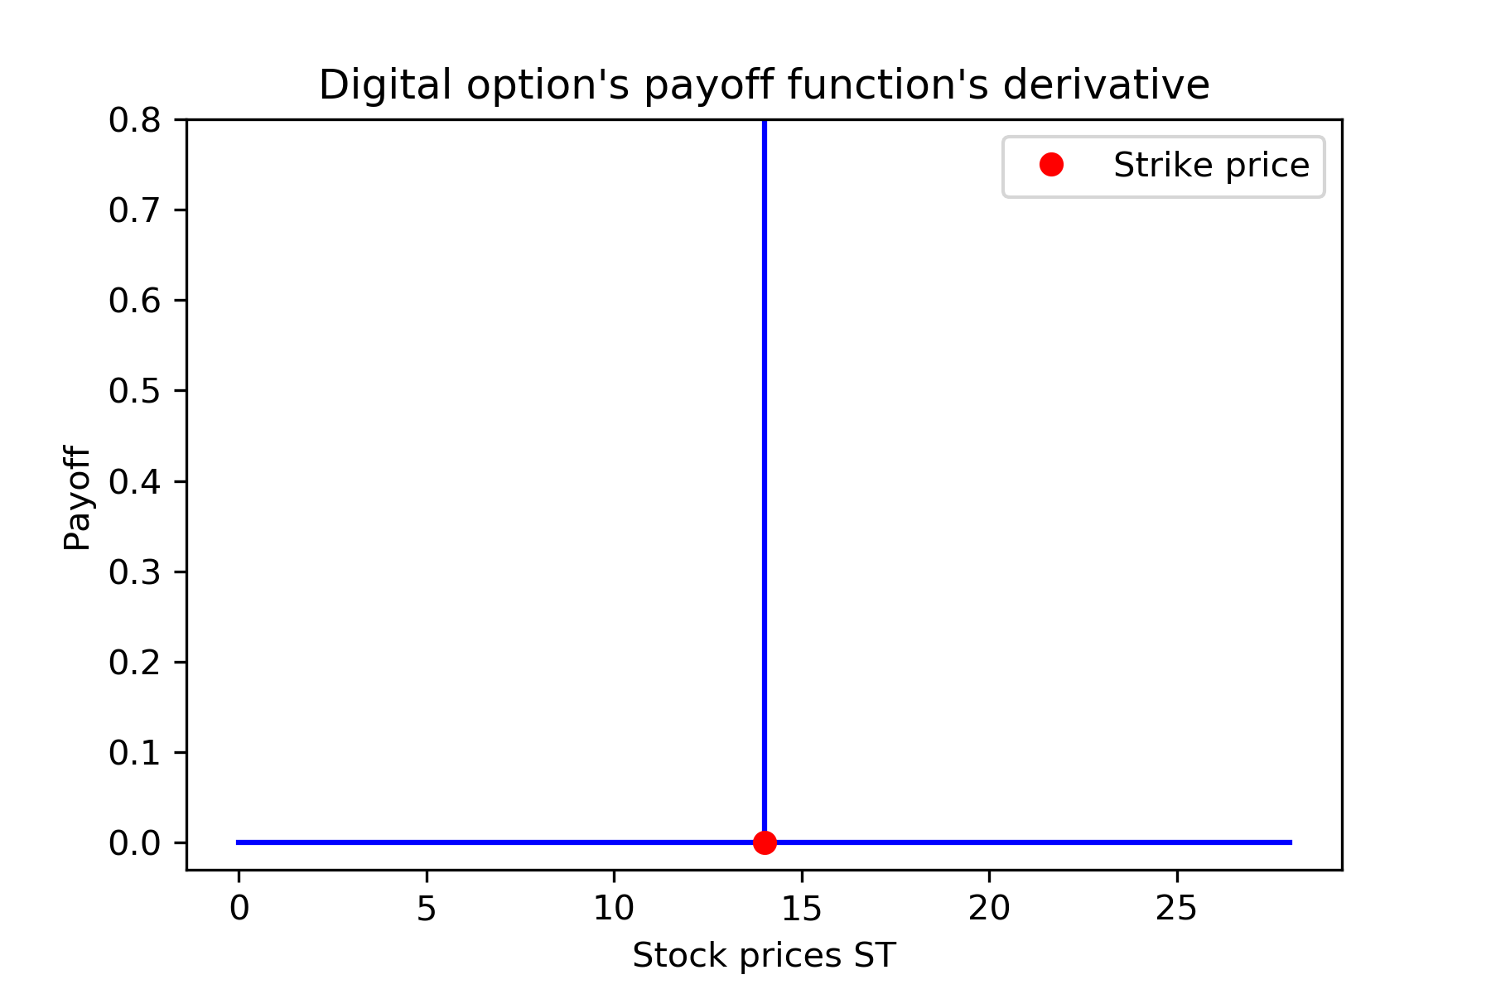
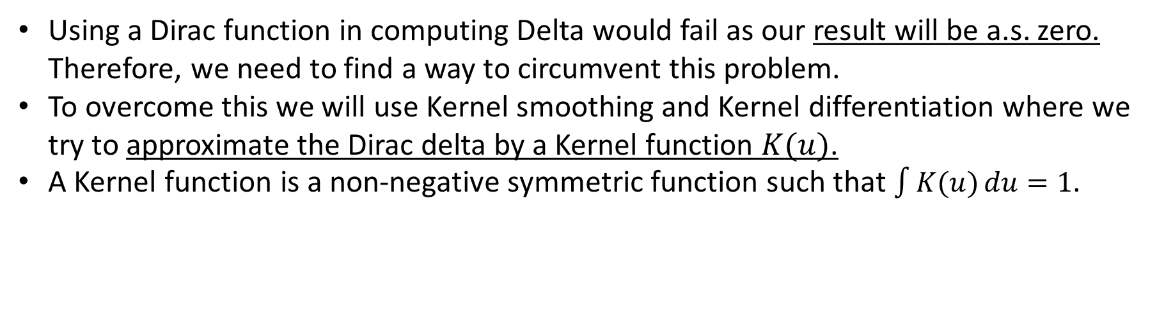
Using a Dirac function in computing Delta would fail as our result will be a.s. zero. Therefore, we need to find a way to circumvent this problem.
To overcome this we will use Kernel smoothing and Kernel differentiation where we try to approximate the Dirac delta by a Kernel function $K(u)$.
A Kernel function is a non-negative symmetric function such that $\int{K(u)}du=1$.

Slide 12
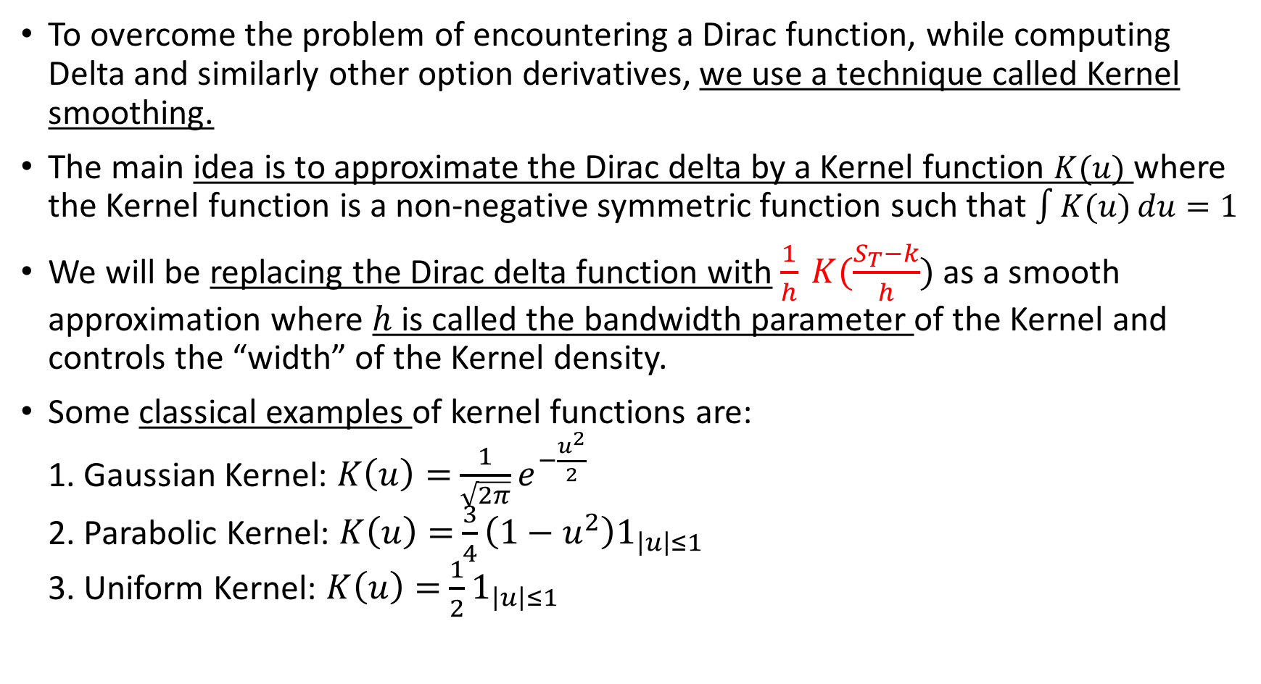
Kernel Smoothing
To overcome the problem of encountering a Dirac function, while computing Delta and similarly other option derivatives, we use a technique called Kernel smoothing.
The main idea is to approximate the Dirac delta by a Kernel function $K(u)$ where the Kernel function is a non-negative symmetric function such that $\int{K(u)}du=1$
We will be replacing the Dirac delta function with $\frac{1}{h} K(\frac{S_{T}−k}{h})$ as a smooth approximation where $h$ is called the bandwidth parameter of the Kernel and controls the “width” of the Kernel density.
Some classical examples of kernel functions are: 1. Gaussian Kernel: $K\left(u\right)=$ $\frac{1}{\sqrt{2π}}e^{−\frac{u^{2}}{2}}$ 2. Parabolic Kernel: $K\left(u\right)=$ $\frac{3}{4}\left(1−u^{2}\right)1_{\left|u\right|≤1}$ 3. Uniform Kernel: $K\left(u\right)=$ $\frac{1}{2}1_{\left|u\right|≤1}$

Slide 13
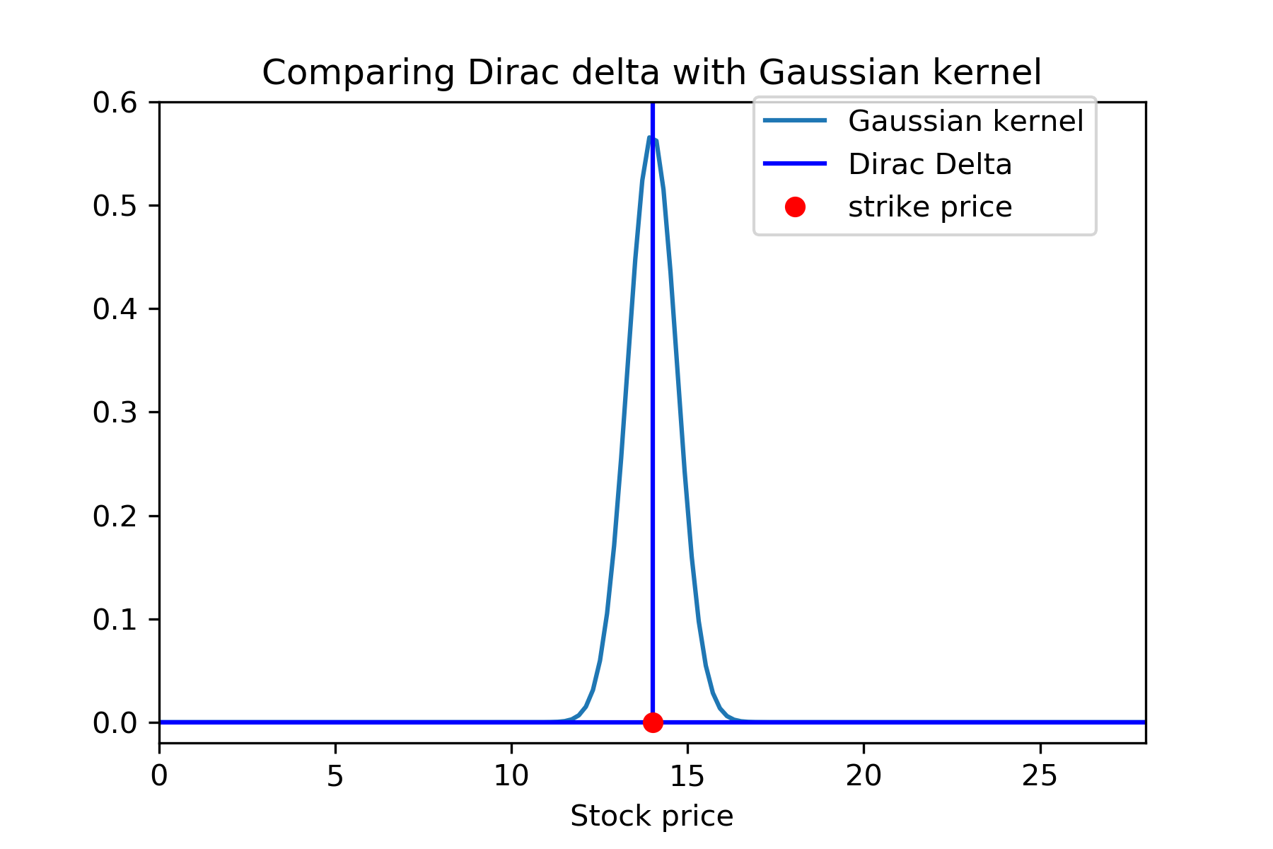
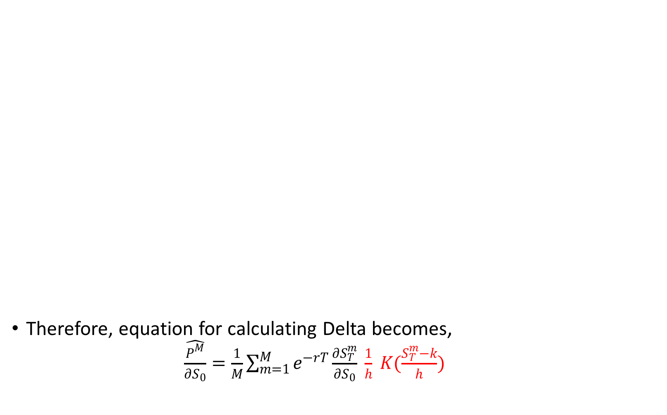
Therefore, equation for calculating Delta becomes, $\hat{\frac{P^{M}}{∂S_{0}}}=\frac{1}{M}\sum_{m=1}^{M}{e^{−rT}\frac{∂S_{T}^{m}}{∂S_{0}} \frac{1}{h} K(\frac{S_{T}^{m}−k}{h})}$

Slide 14
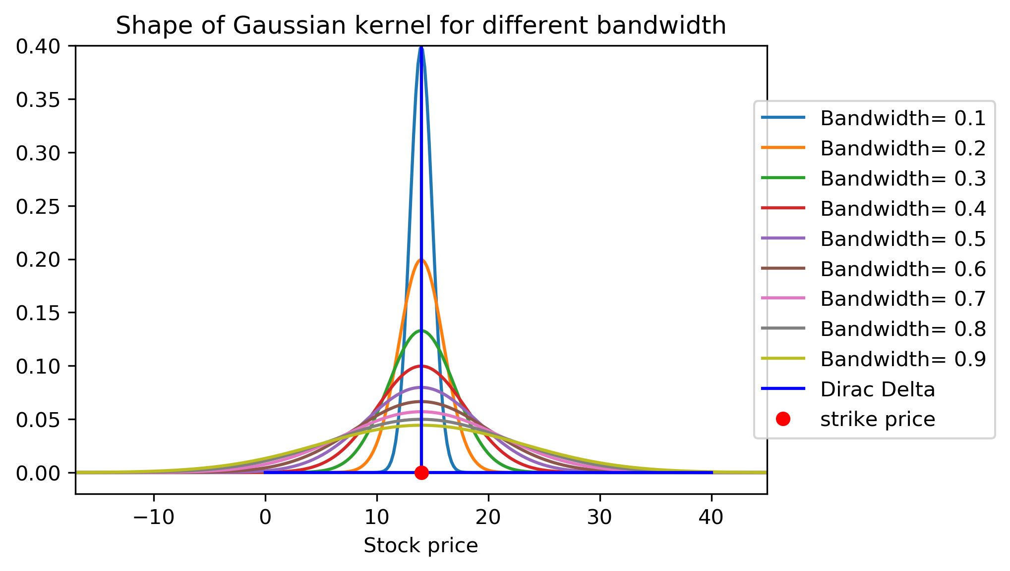
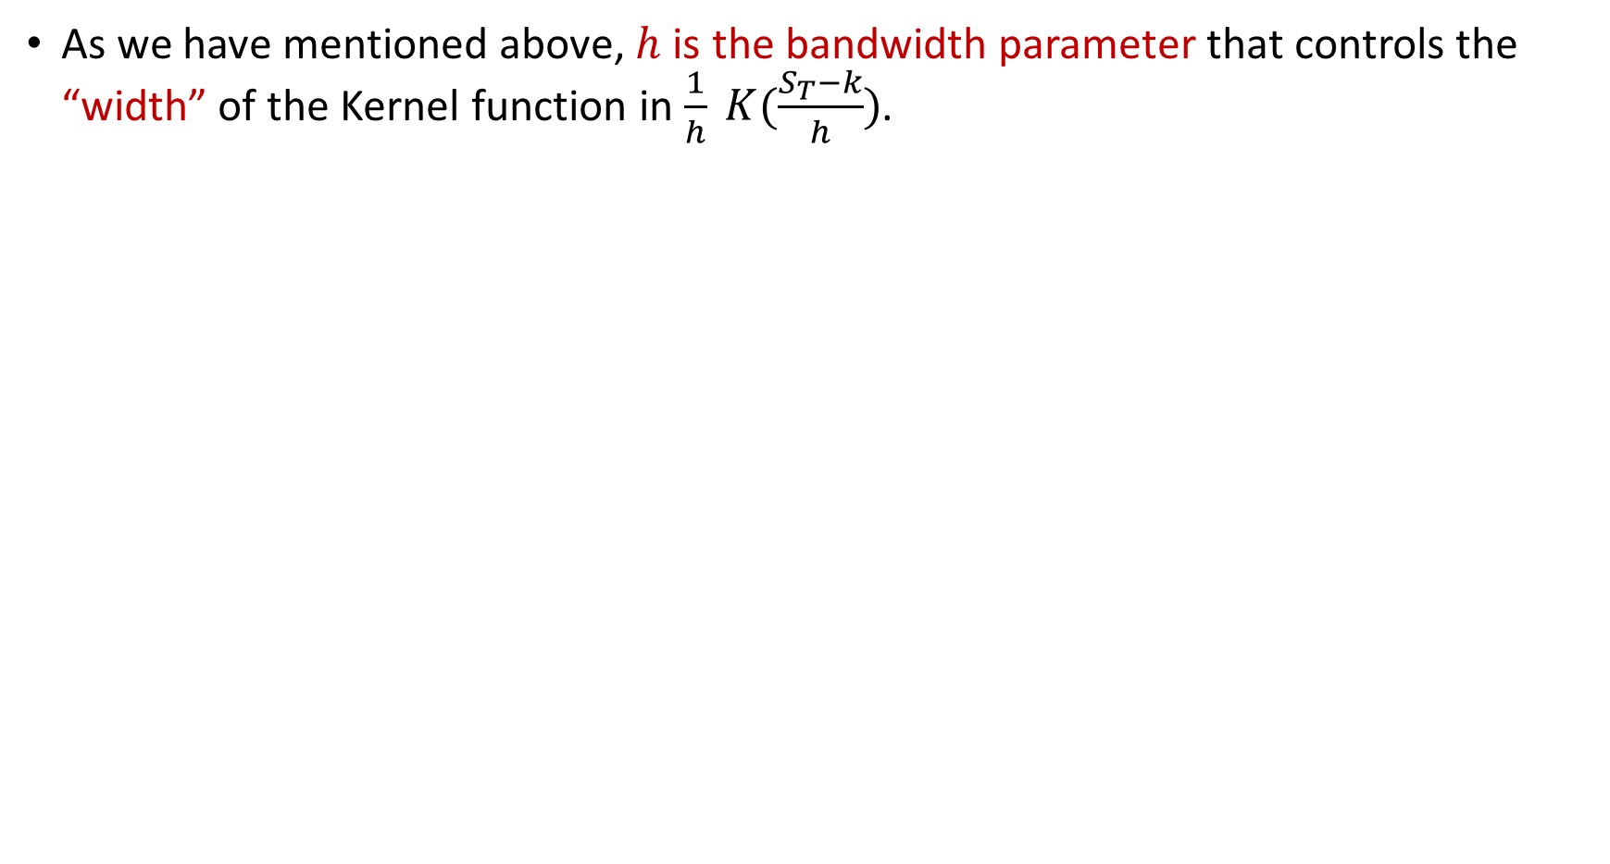
Bias and Variance
As we have mentioned above, $h$ is the bandwidth parameter that controls the “width” of the Kernel function in $\frac{1}{h} K(\frac{S_{T}−k}{h})$.

Slide 15
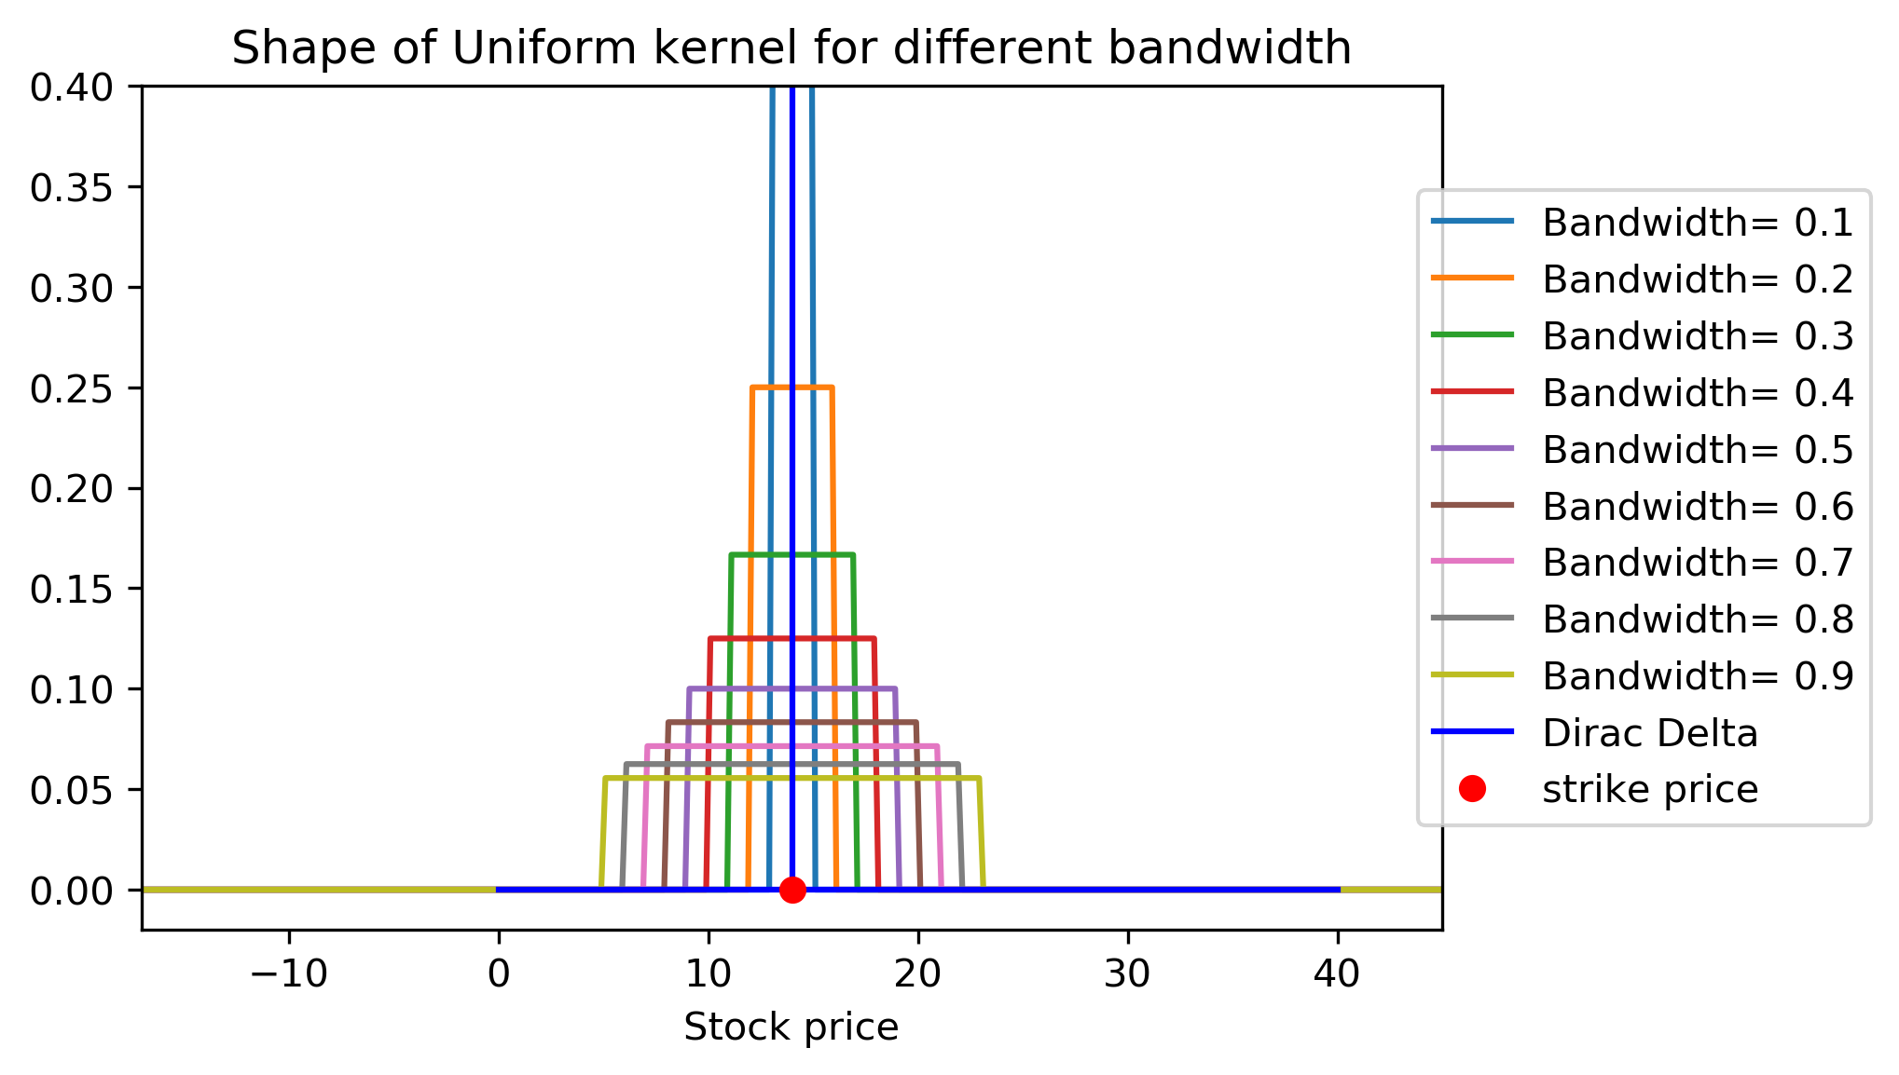
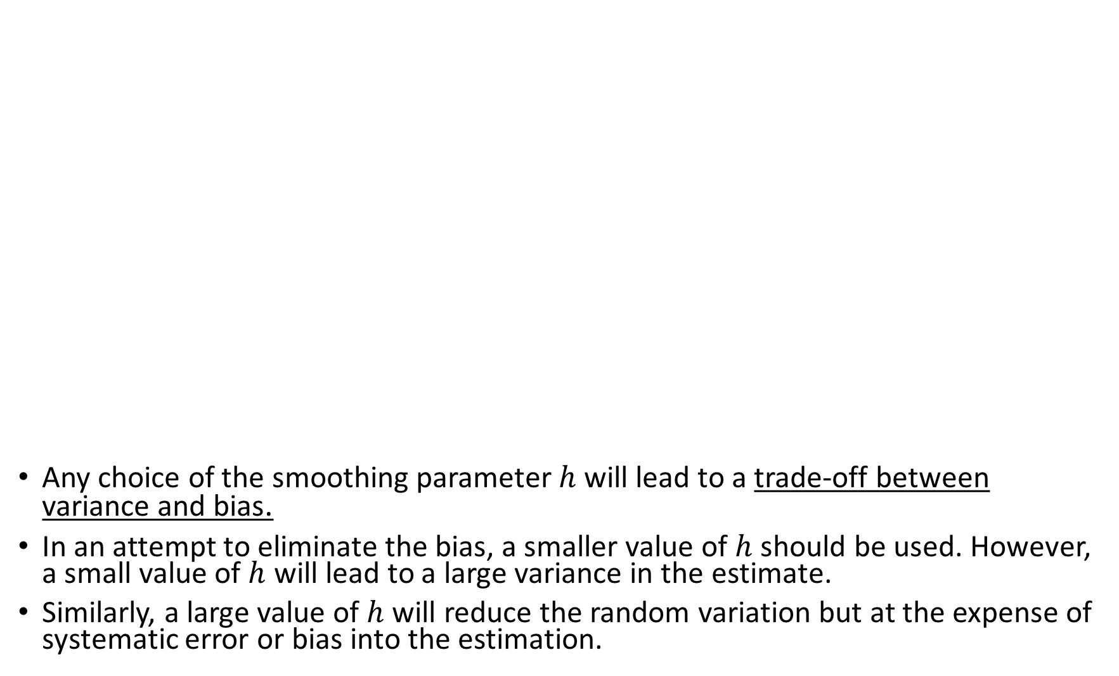
Any choice of the smoothing parameter $h$ will lead to a trade-off between variance and bias.
In an attempt to eliminate the bias, a smaller value of $h$ should be used. However, a small value of $h$ will lead to a large variance in the estimate.
Similarly, a large value of $h$ will reduce the random variation but at the expense of systematic error or bias into the estimation.

Slide 16
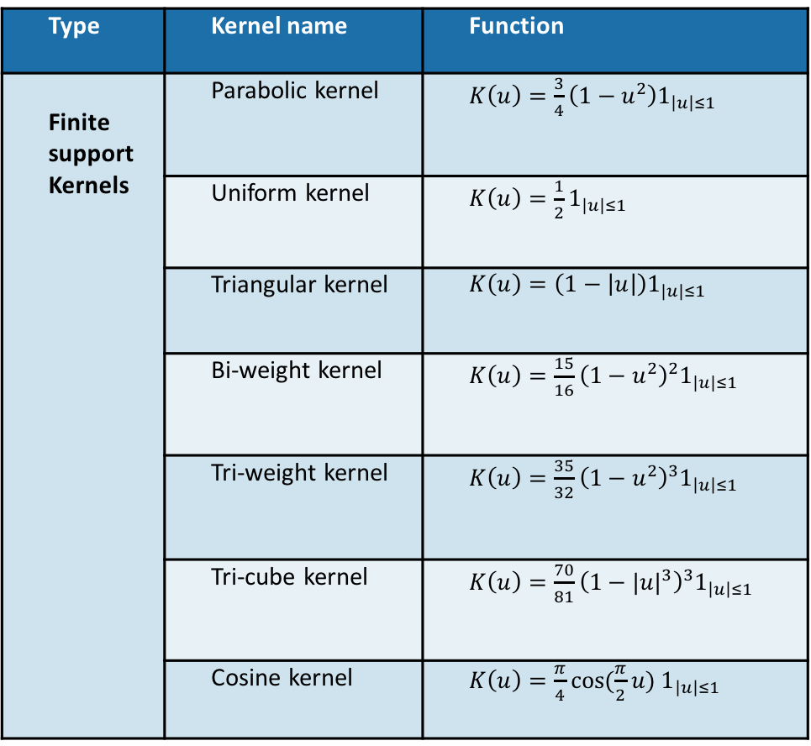
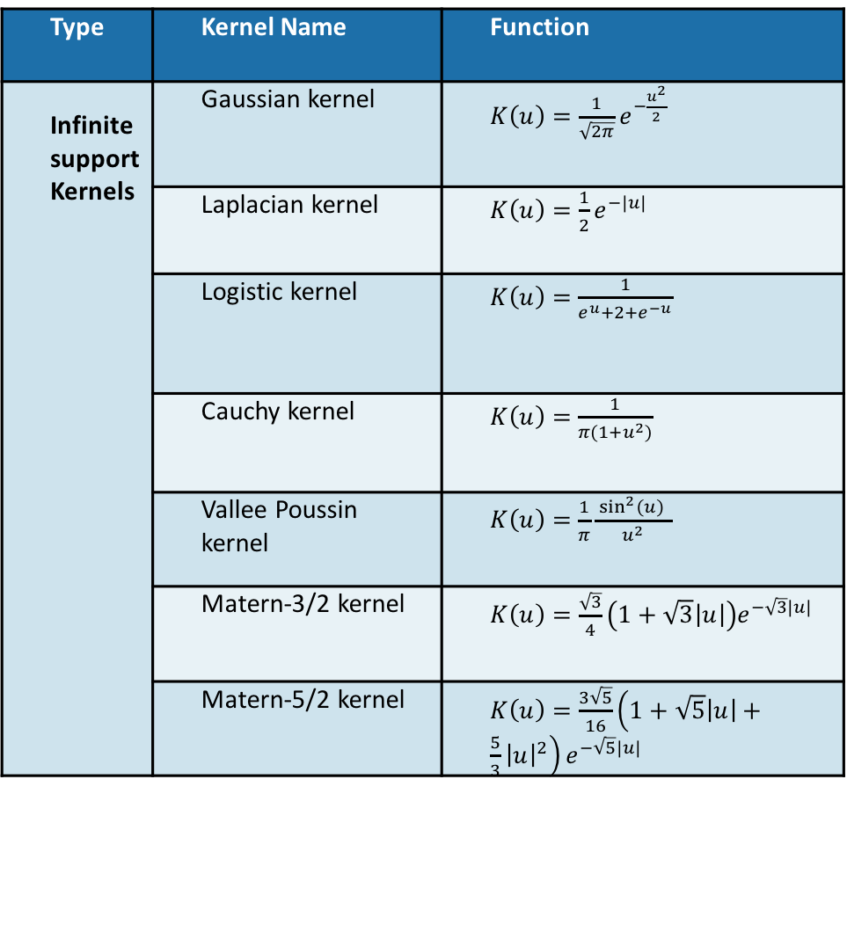
Kernel Functions
We have used a total of 14 Kernels in our study. They are as follows,
Type | Kernel name | Function
Finite support Kernels | Parabolic kernel | $K\left(u\right)=\frac{3}{4}\left(1−u^{2}\right)1_{\left|u\right|≤1}$
 | Uniform kernel | $K\left(u\right)=\frac{1}{2}1_{\left|u\right|≤1}$
 | Triangular kernel | $K\left(u\right)=\left(1−\left|u\right|\right)1_{\left|u\right|≤1}$
 | Bi-weight kernel | $K\left(u\right)={\frac{15}{16}\left(1−u^{2}\right)}^{2}1_{\left|u\right|≤1}$
 | Tri-weight kernel | $K\left(u\right)={\frac{35}{32}\left(1−u^{2}\right)}^{3}1_{\left|u\right|≤1}$
 | Tri-cube kernel | $K\left(u\right)={\frac{70}{81}\left(1−{|u|}^{3}\right)}^{3}1_{\left|u\right|≤1}$
 | Cosine kernel | $K\left(u\right)=\frac{π}{4}cos⁡(\frac{π}{2}u) 1_{\left|u\right|≤1}$
Type | Kernel Name | Function
Infinite support Kernels | Gaussian kernel | $K\left(u\right)=\frac{1}{\sqrt{2π}}e^{−\frac{u^{2}}{2}}$
 | Laplacian kernel | $K\left(u\right)=\frac{1}{2}e^{−|u|}$
 | Logistic kernel | $K\left(u\right)=$ $\frac{1}{e^{u}+2+e^{−u}}$
 | Cauchy kernel | $K\left(u\right)=$ $\frac{1}{π(1+u^{2})}$
 | Vallee Poussin kernel | $K\left(u\right)=$ $\frac{1}{π}\frac{\sin^{2}\left(u\right) }{u^{2}}$
 | Matern-3/2 kernel | $K\left(u\right)=\frac{\sqrt{3}}{4}\left(1+\sqrt{3}\left|u\right|\right)e^{−\sqrt{3}|u|}$
 | Matern-5/2 kernel | $K\left(u\right)=\frac{3\sqrt{5}}{16}\left(1+\sqrt{5}\left|u\right|+\frac{5}{3}{\left|u\right|}^{2}\right)e^{−\sqrt{5}|u|}$

Slide 17
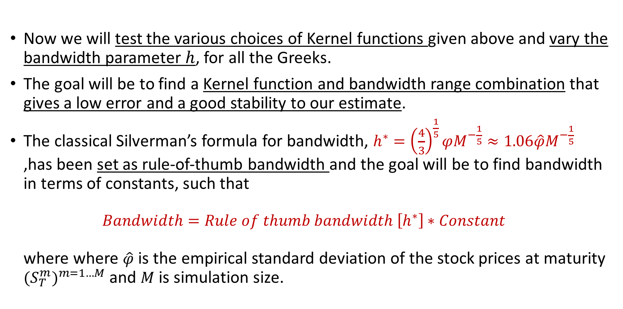
Numerical Results
Now we will test the various choices of Kernel functions given above and vary the bandwidth parameter $h$, for all the Greeks.
The goal will be to find a Kernel function and bandwidth range combination that gives a low error and a good stability to our estimate.
The classical Silverman’s formula for bandwidth, $h^{∗}={\left(\frac{4}{3}\right)}^{\frac{1}{5}}φM^{−\frac{1}{5}}≈1.06\hat{φ}M^{−\frac{1}{5}}$ ,has been set as rule-of-thumb bandwidth and the goal will be to find bandwidth in terms of constants, such that $Bandwidth=Rule of thumb bandwidth \left[h^{∗}\right]∗Constant$ where where $\hat{φ}$ is the empirical standard deviation of the stock prices at maturity ${(S_{T}^{m})}^{m=1…M}$ and $M$ is simulation size.

Slide 18
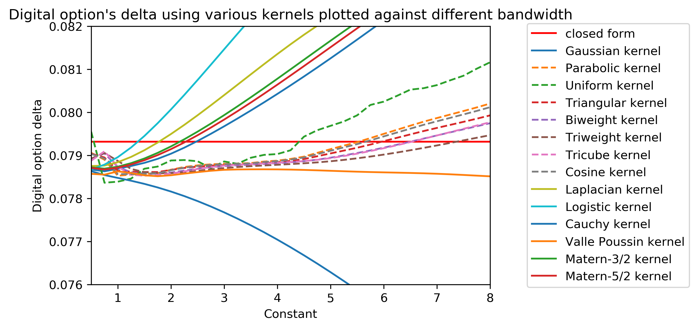
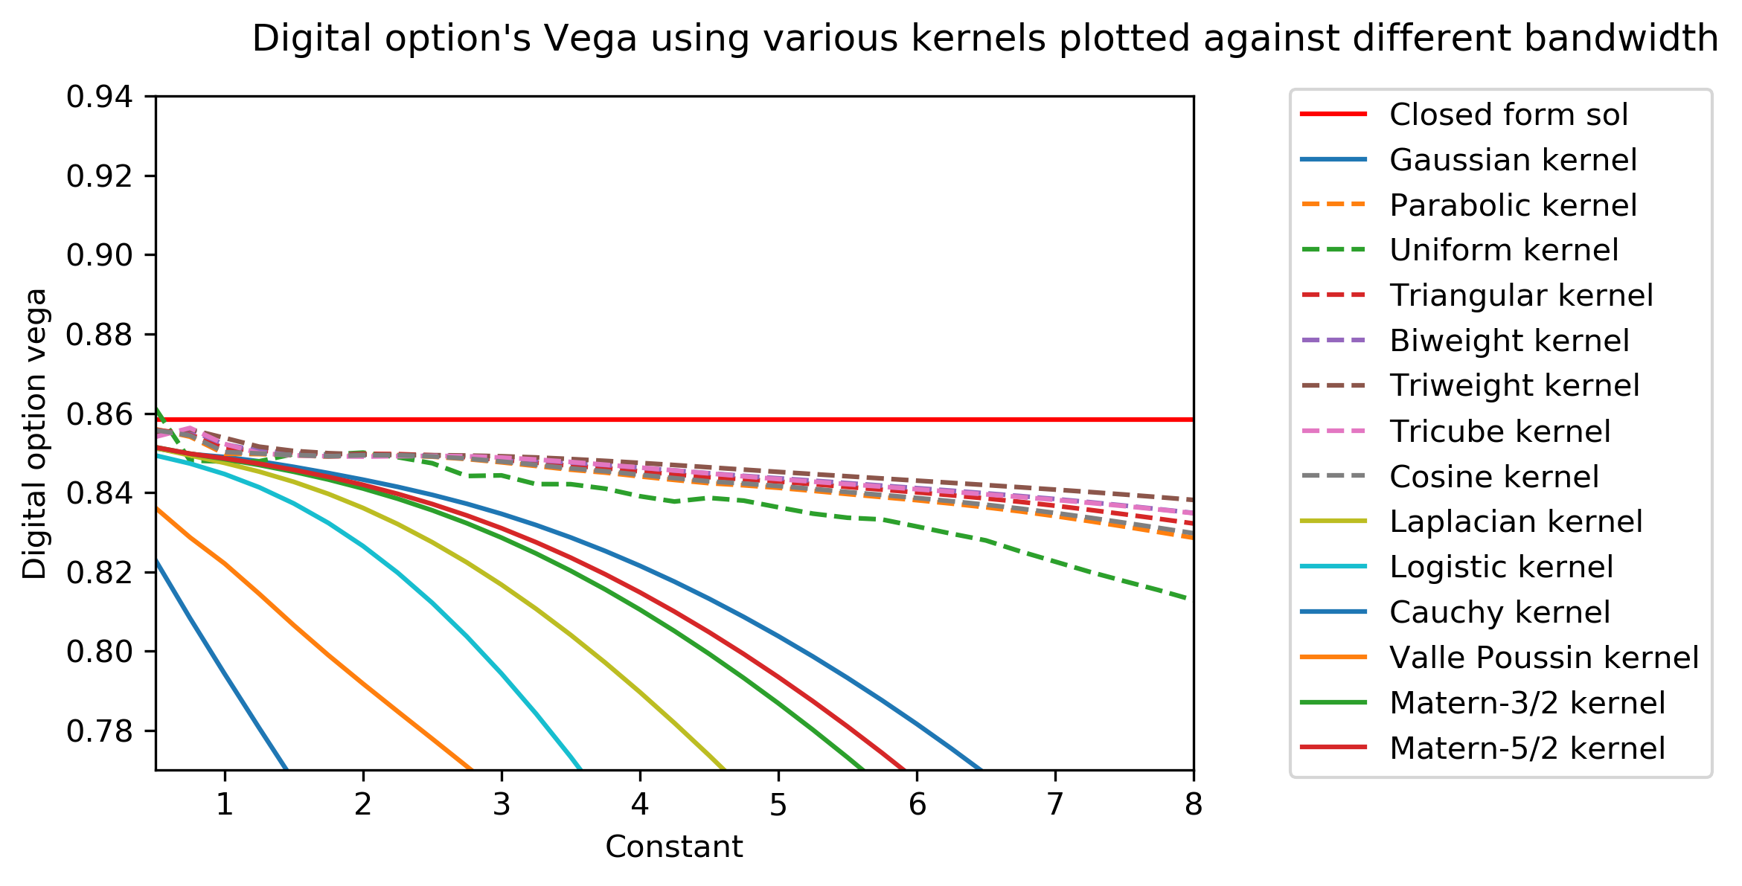
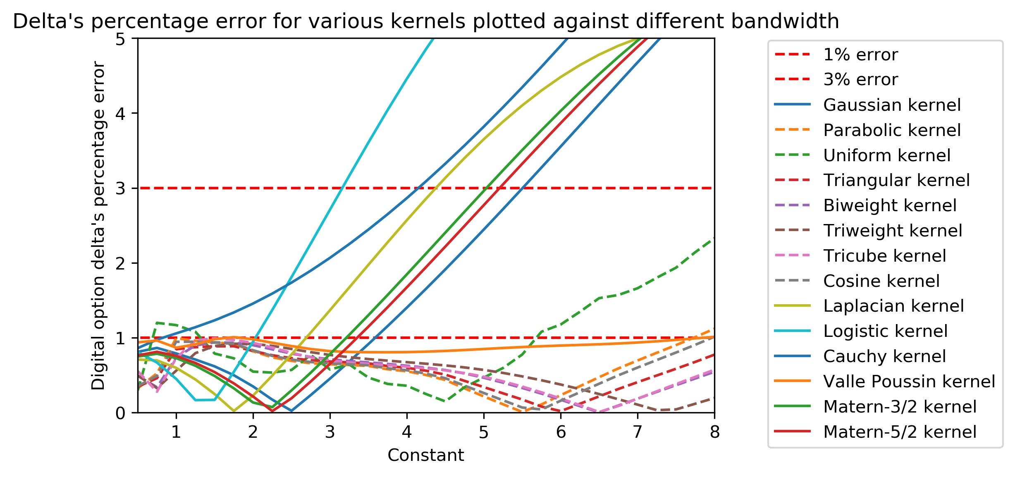
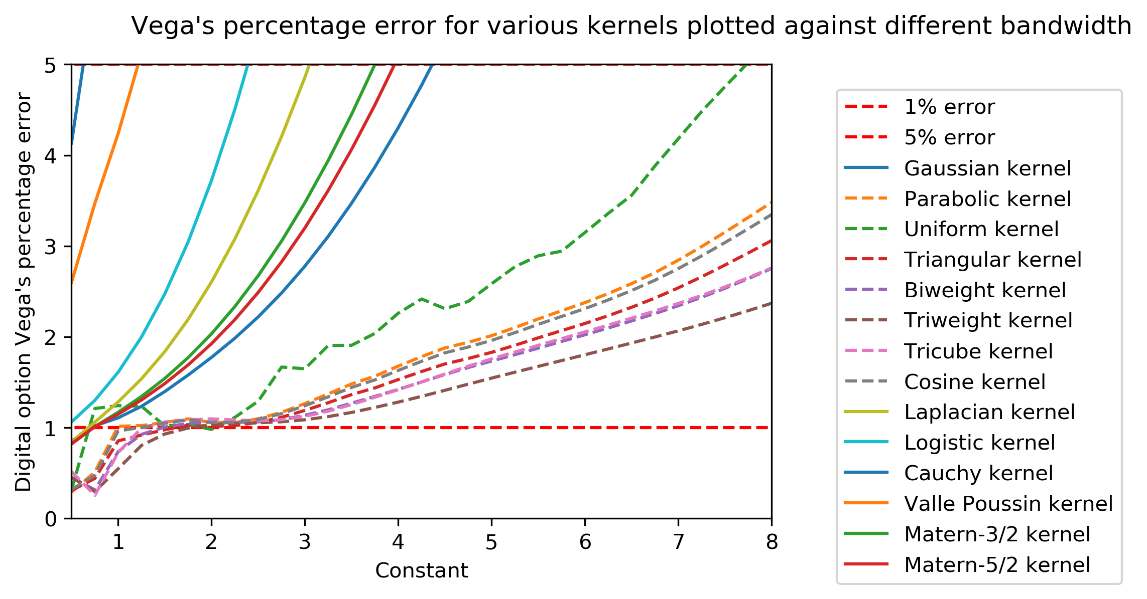
Delta
Vega

Slide 19
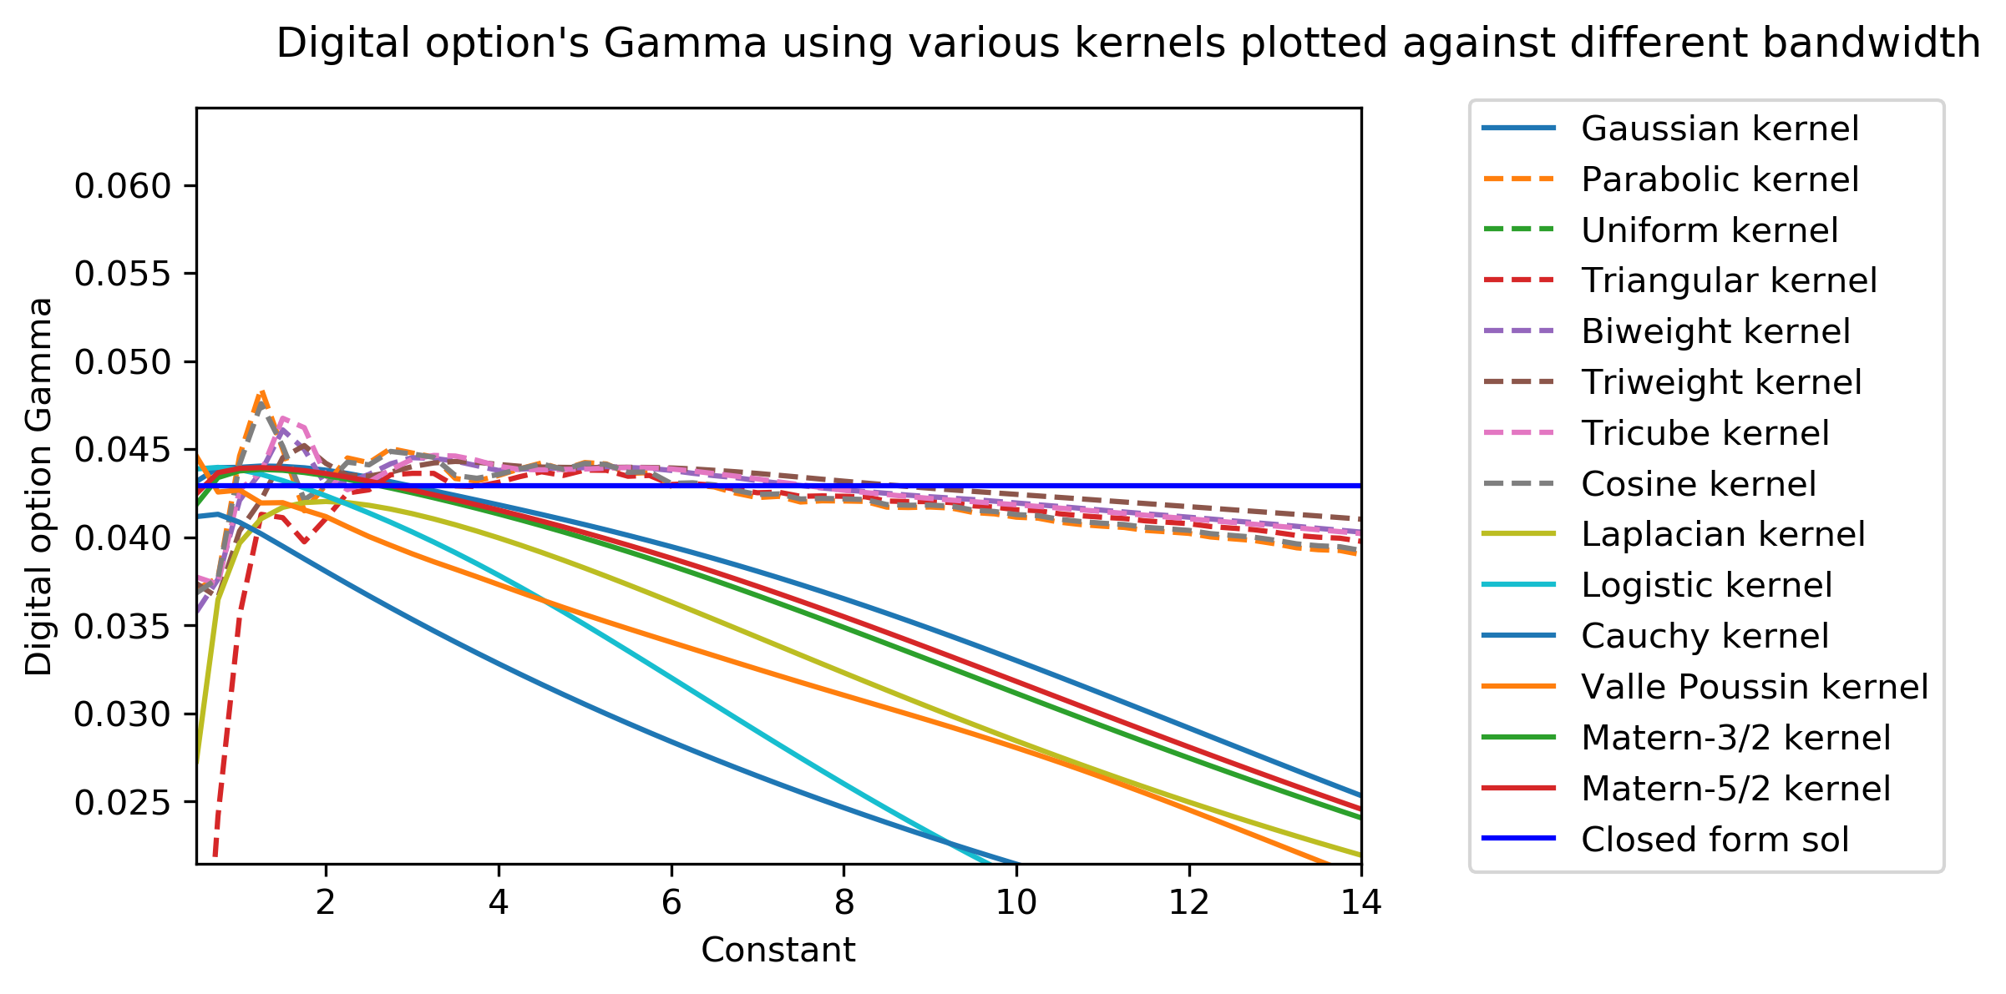
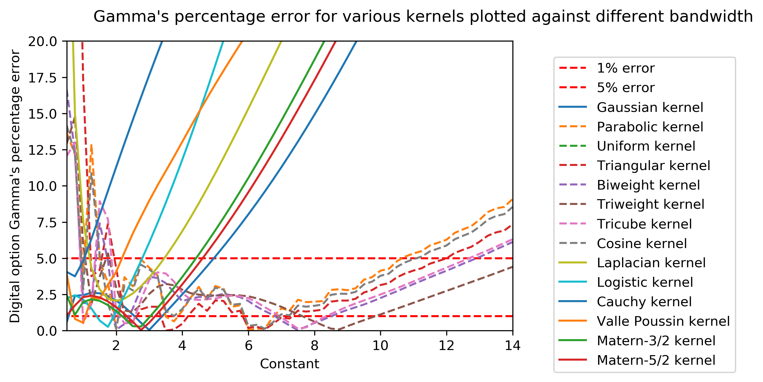
In order to estimate second order Greeks (Gamma, Vomma and Vanna), we differentiate the Kernel function itself. This technique is called Kernel Differentiation. Gamma

Slide 20
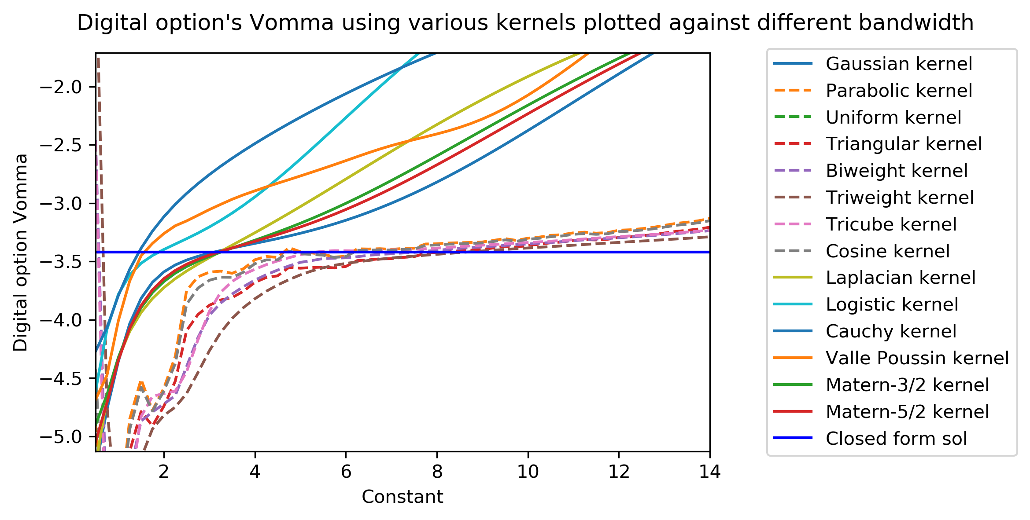
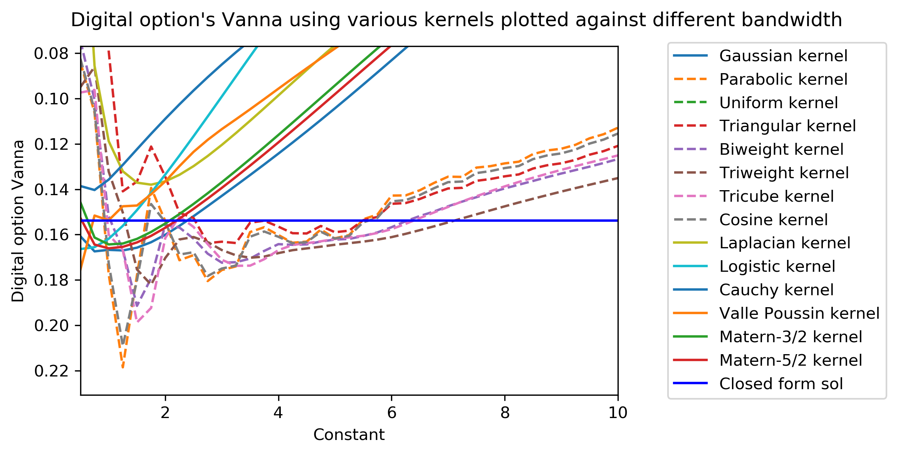
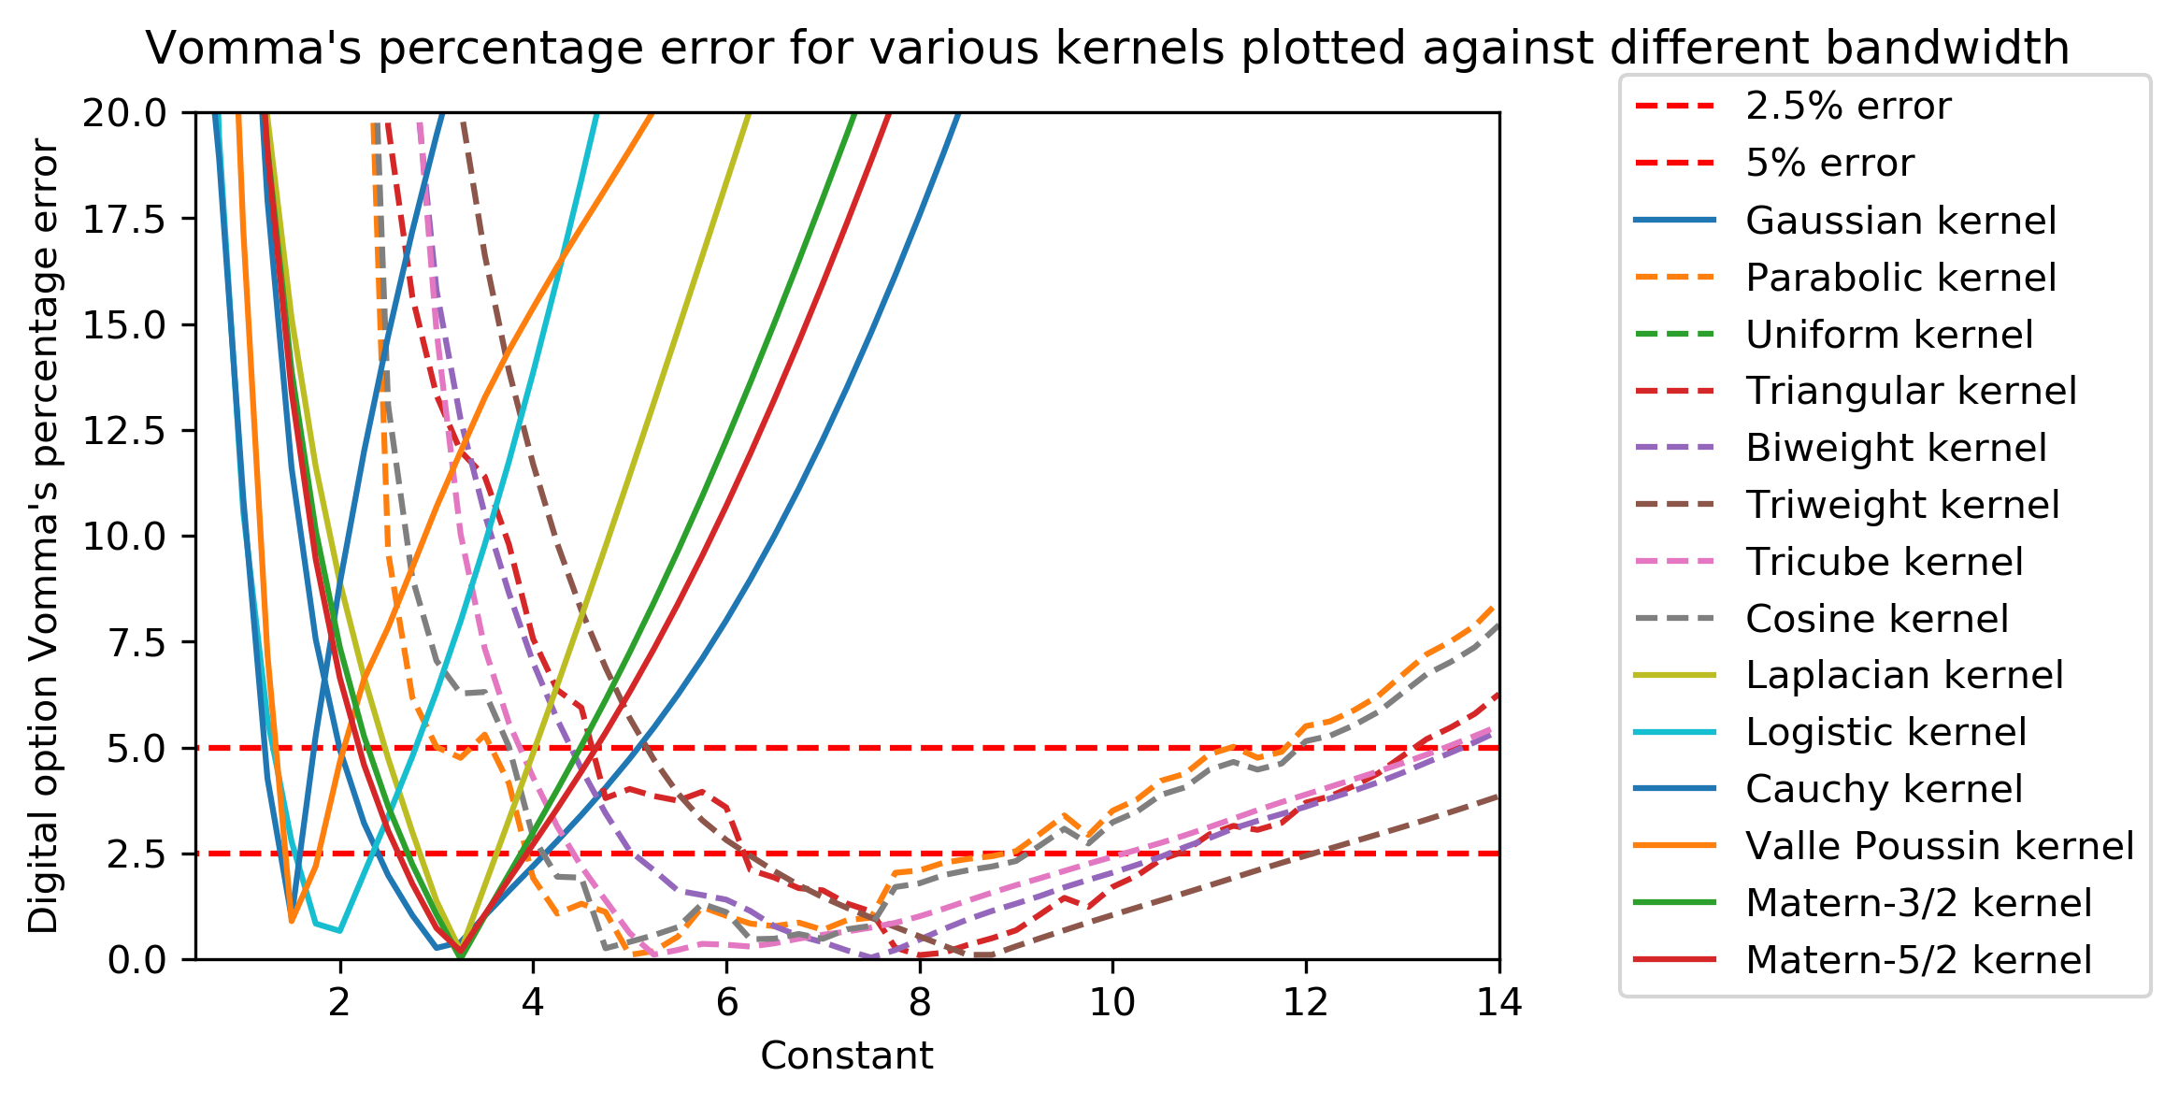
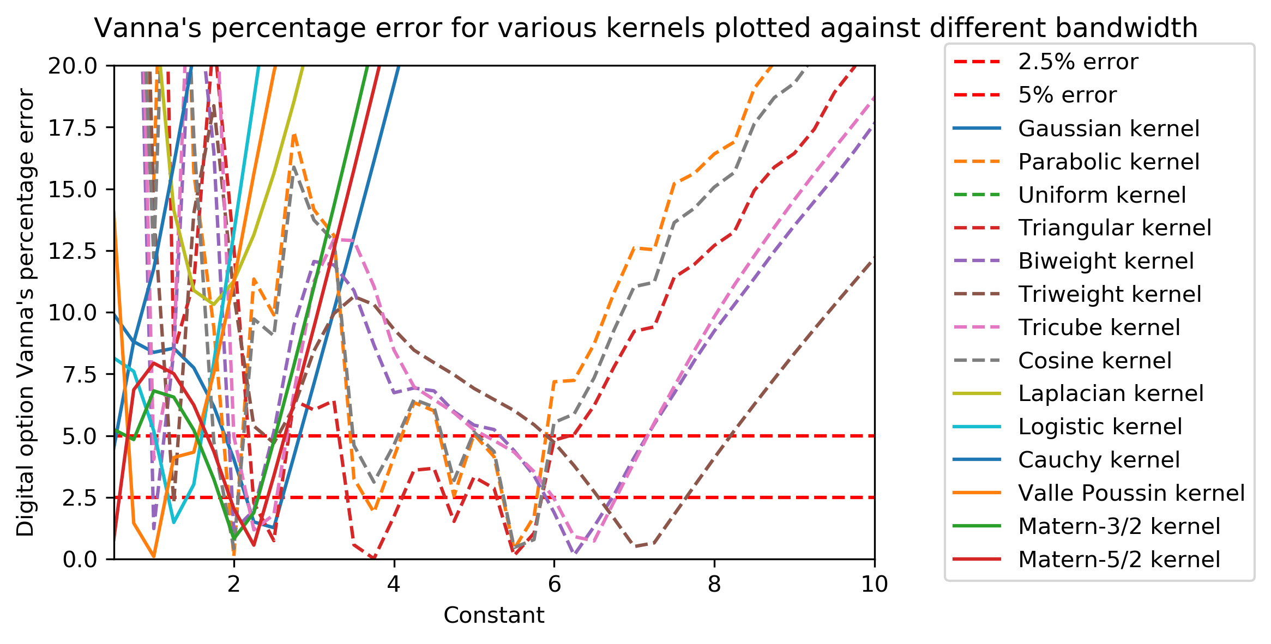
Vomma Vanna

Slide 21
Explanation:
The solid lines represent infinite support Kernels. Whereas, the dotted lines represent finite-support Kernels
Infinite-support Kernels give more accurate results when the constant/bandwidth has a smaller value. Usually between constants one to four.
Finite support Kernels are the most accurate for a larger value of constant/bandwidth range. Usually between constants around six to eight.
Infinite kernels have a fast rate of change with respect to the constant/bandwidth. The error shoots up very quickly outside the optimal range. This implies that they are stable for a short range of bandwidth only.
Finite support Kernels have a slow rate of change with respect to constant/bandwidth. Even outside their optimal range, the error seems to be low and results are still quite accurate and stable.
Finite support kernels are more stable because while approximating a Dirac delta, finite support Kernels have cut-off points. This means that their bias, as bandwidth increases, is finite. Infinite Kernels do not have any cut off points, thus the bias propagates to infinity leading to more unstable approximations

Slide 22
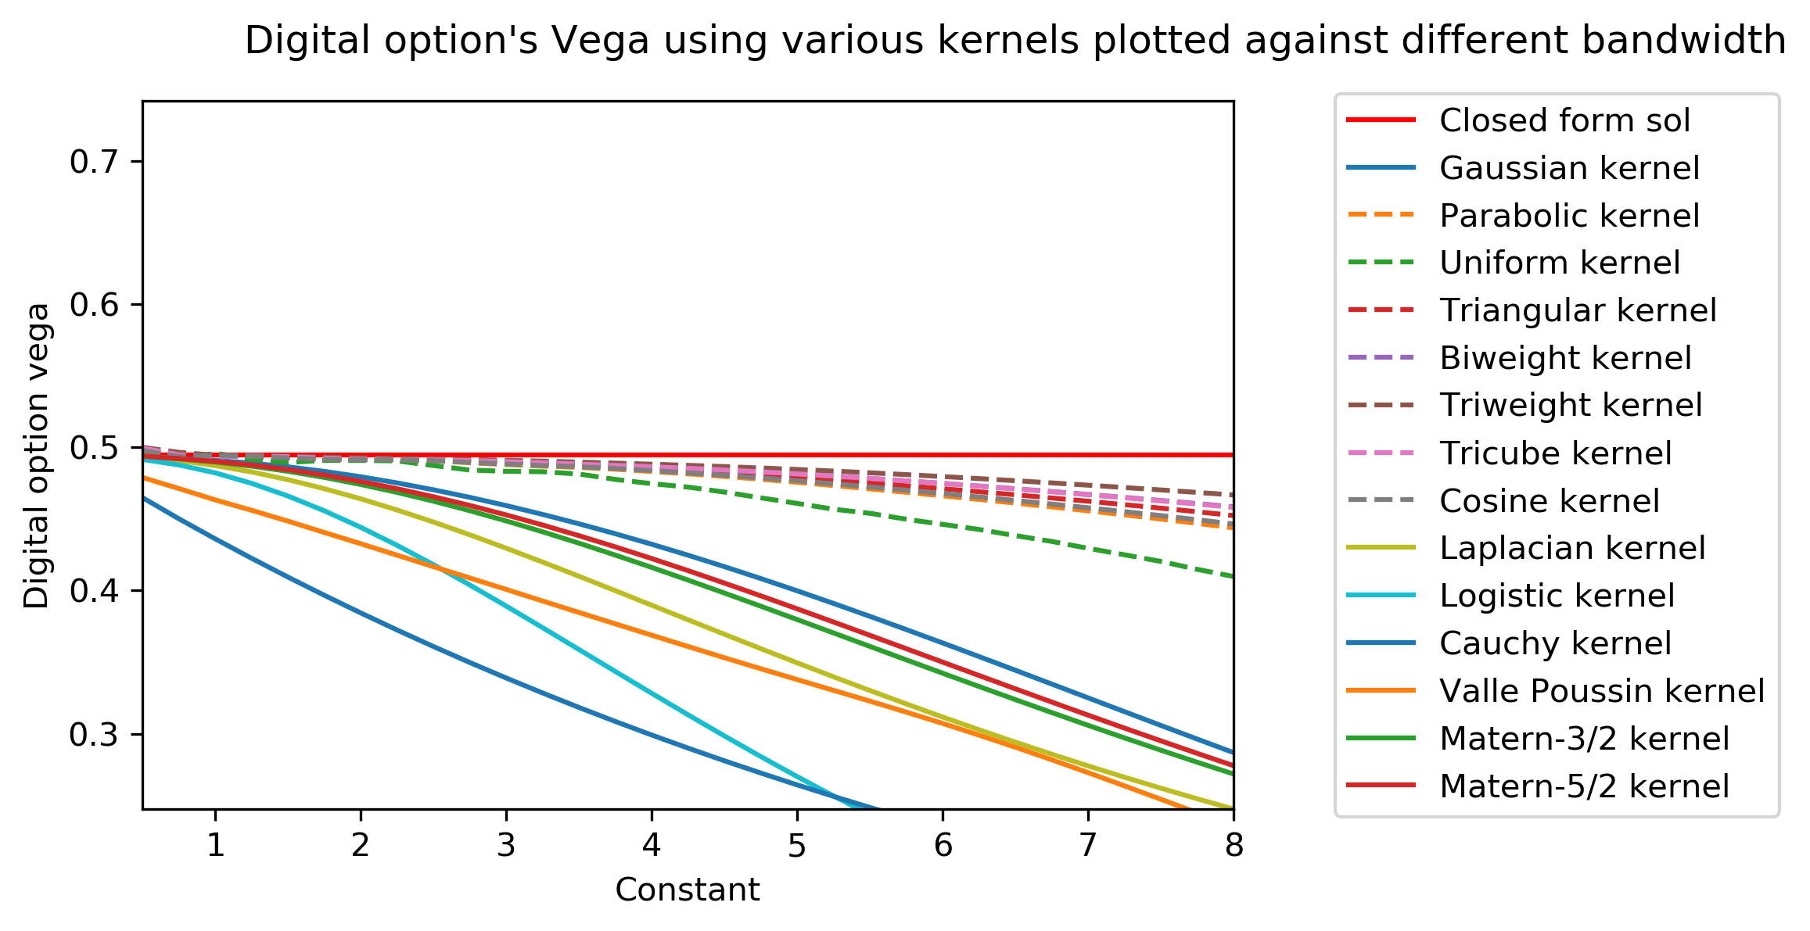
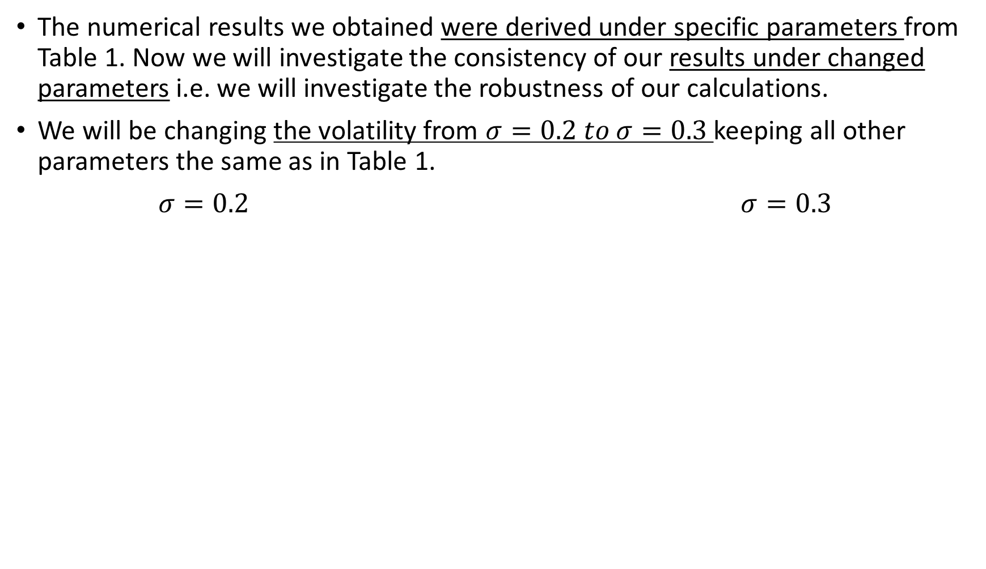
Robustness
The numerical results we obtained were derived under specific parameters from Table 1. Now we will investigate the consistency of our results under changed parameters i.e. we will investigate the robustness of our calculations.
We will be changing the volatility from $σ=0.2 to σ=0.3$ keeping all other parameters the same as in Table 1.
$σ=0.2$ $σ=0.3$

Slide 23
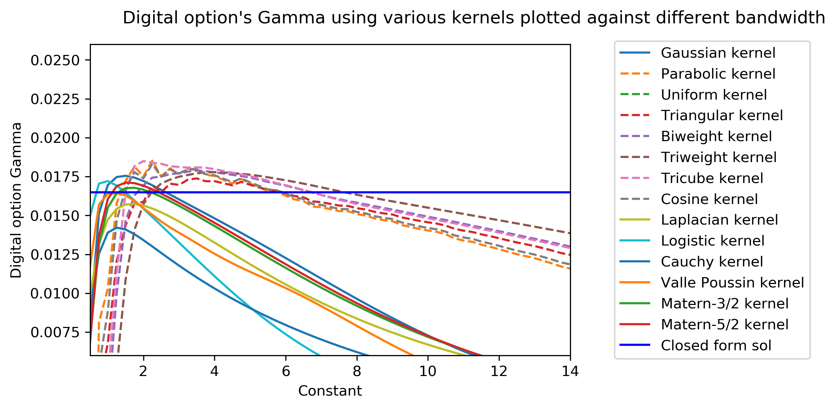
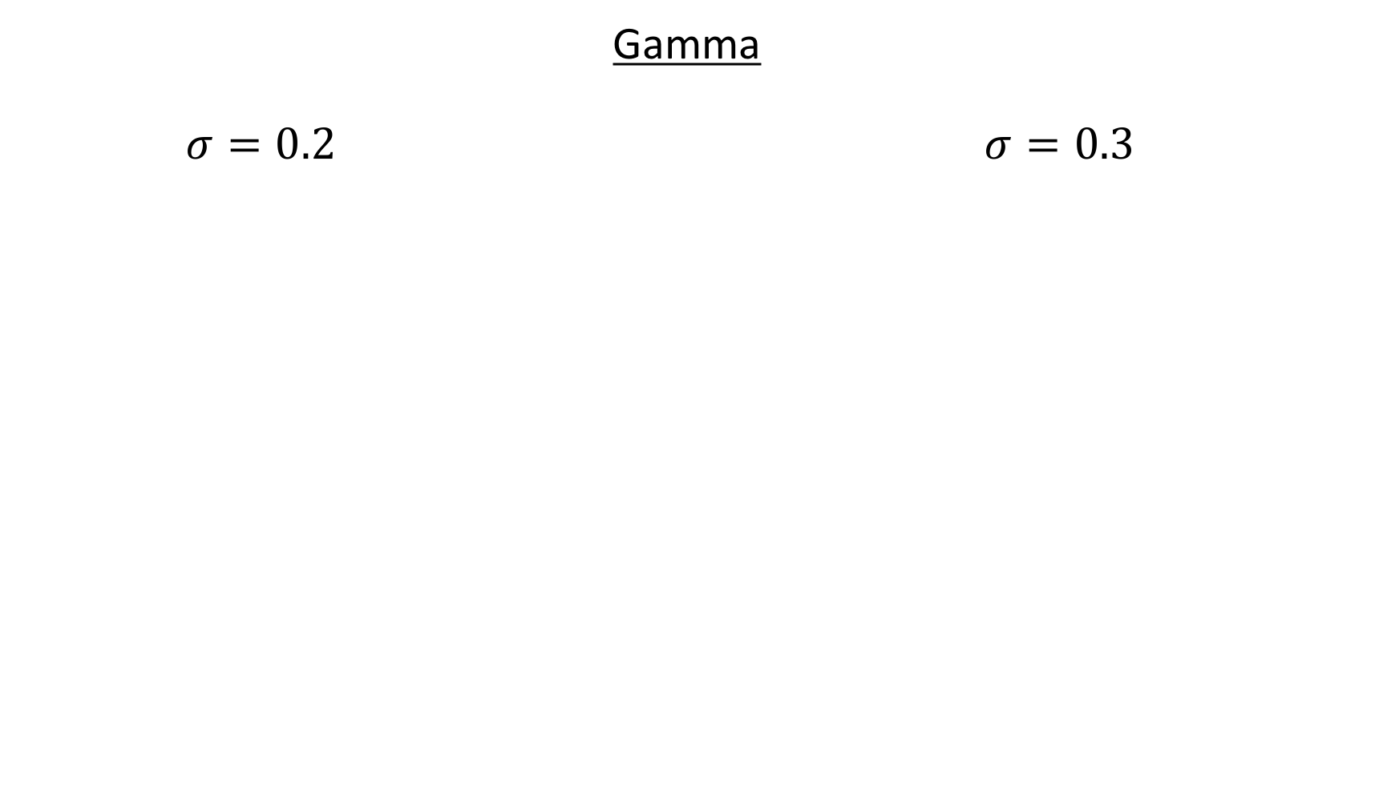
Gamma $σ=0.2$ $σ=0.3$

Slide 24
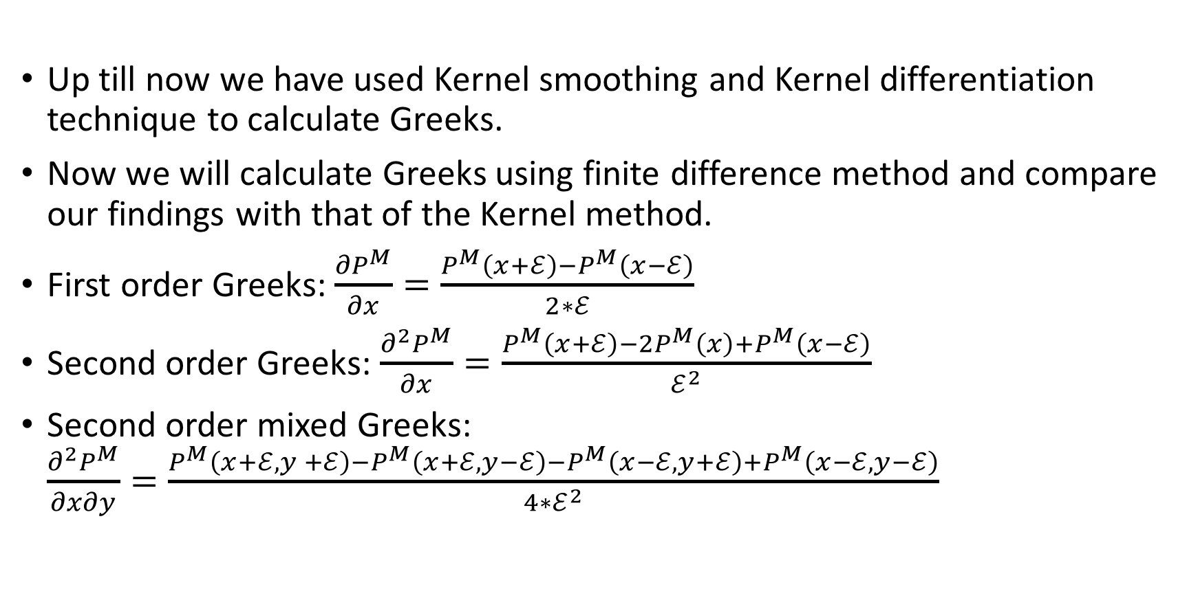
Finite Difference Method
Up till now we have used Kernel smoothing and Kernel differentiation technique to calculate Greeks.
Now we will calculate Greeks using finite difference method and compare our findings with that of the Kernel method.
First order Greeks: $\frac{{∂P}^{M}}{∂x}=\frac{P^{M}\left(x+ℰ\right)−P^{M}\left(x−ℰ\right)}{2∗ℰ}$
Second order Greeks: $\frac{{∂^{2}P}^{M}}{∂x}=\frac{P^{M}\left(x+ℰ\right)−2P^{M}\left(x\right)+P^{M}\left(x−ℰ\right)}{ℰ^{2}}$
Second order mixed Greeks: $\frac{{∂^{2}P}^{M}}{∂x∂y}=\frac{P^{M}\left(x+ℰ,y +ℰ\right)−P^{M}\left(x+ℰ,y−ℰ\right)−P^{M}\left(x−ℰ,y+ℰ\right)+P^{M}\left(x−ℰ,y−ℰ\right)}{{4∗ℰ}^{2}}$

Slide 25
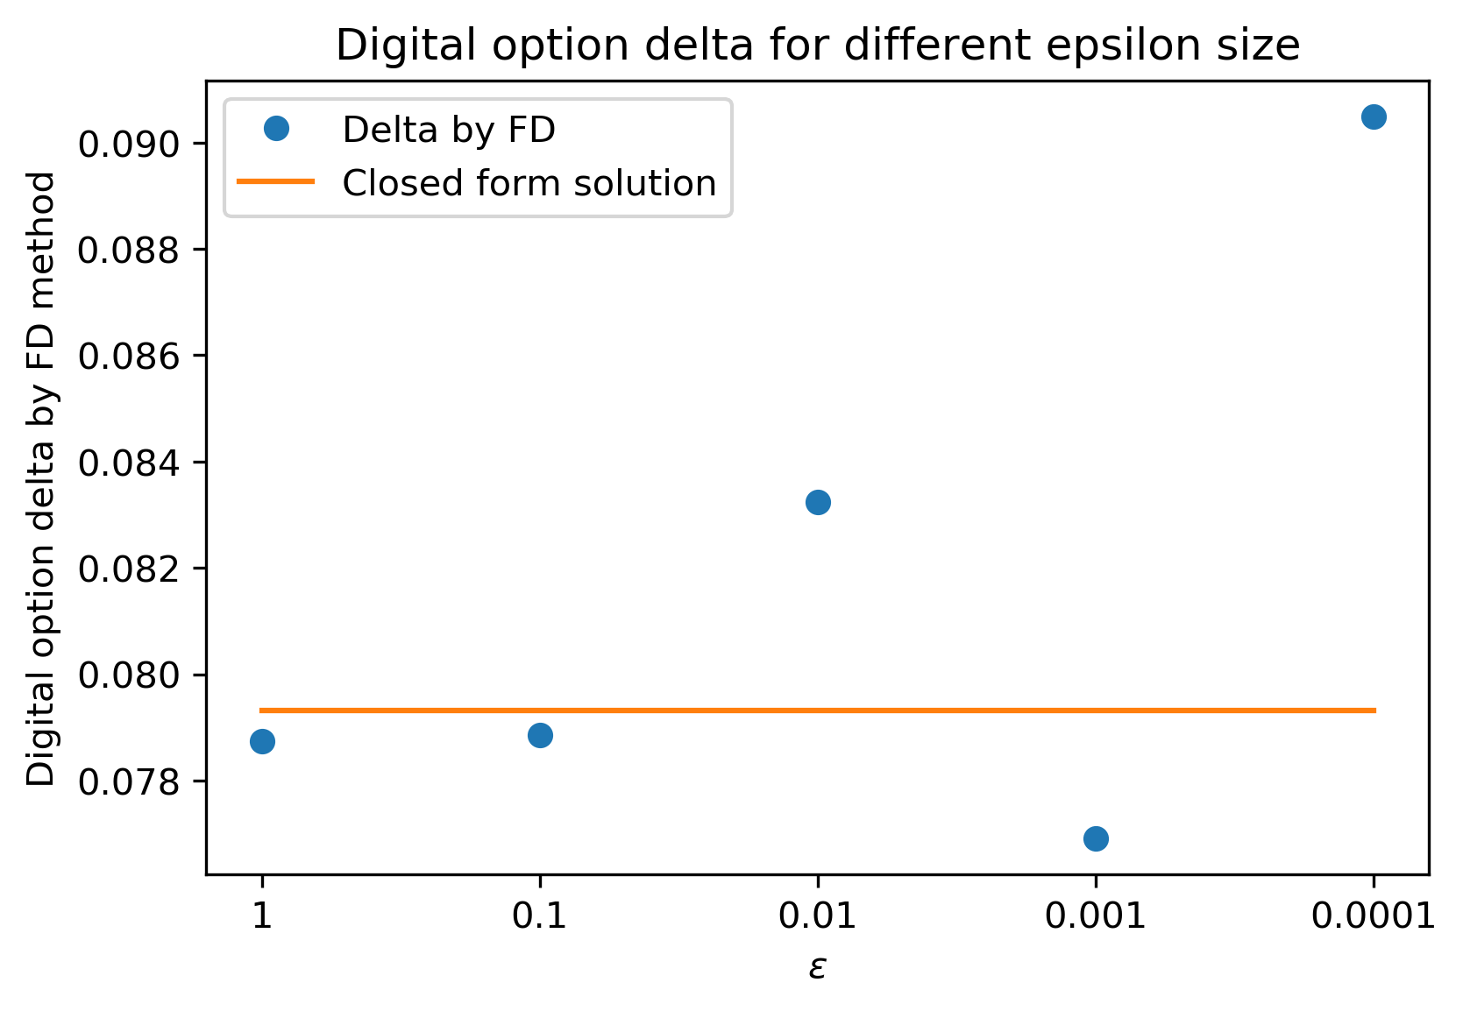
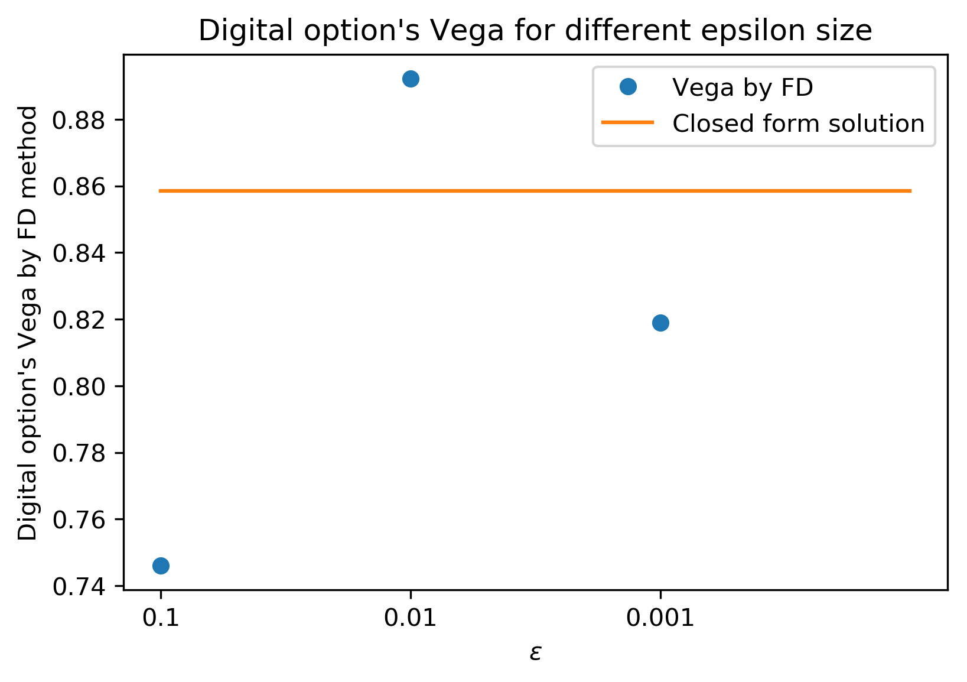
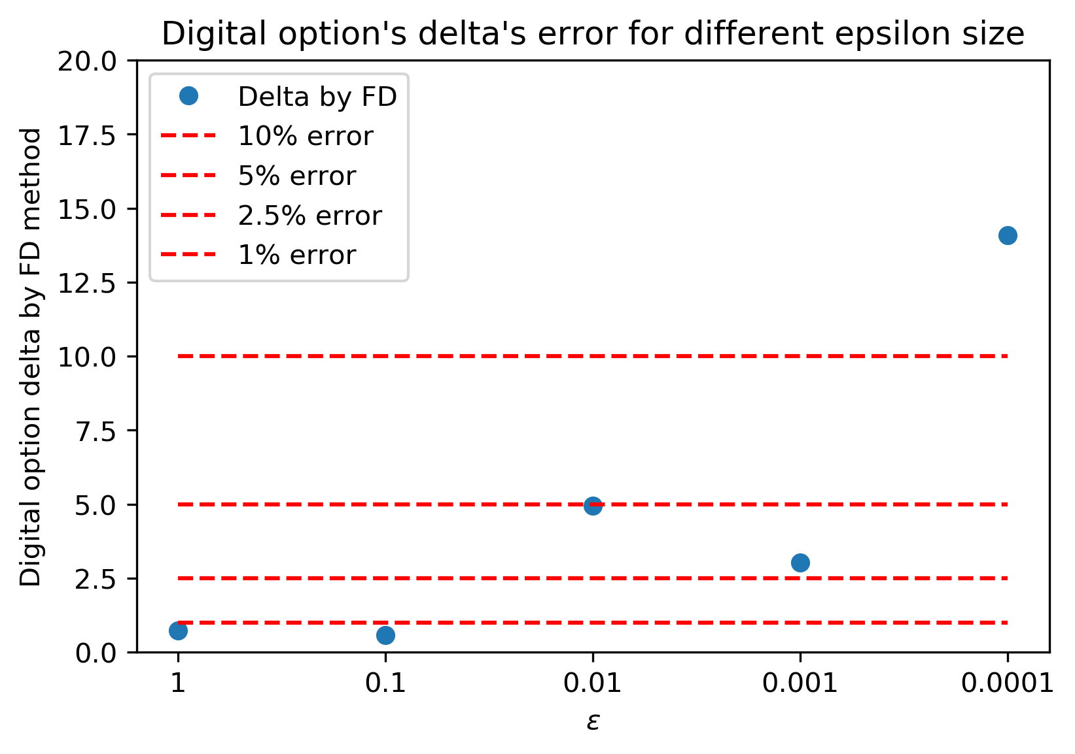
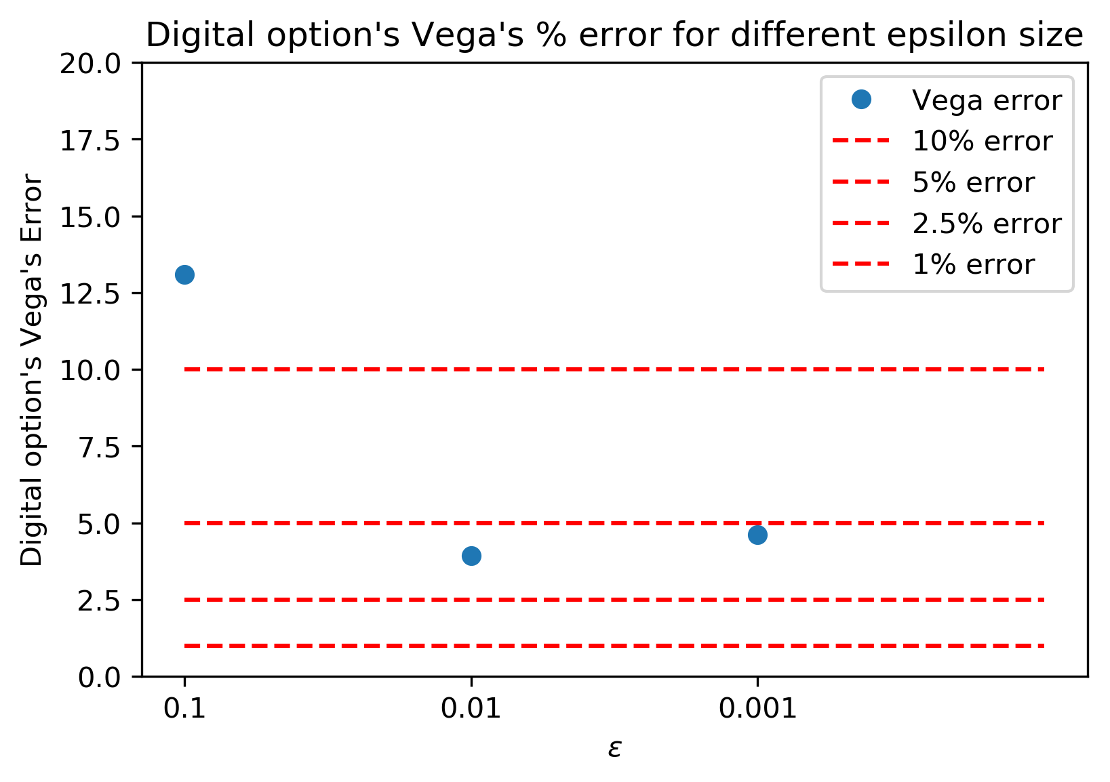
Delta Vega

Slide 26
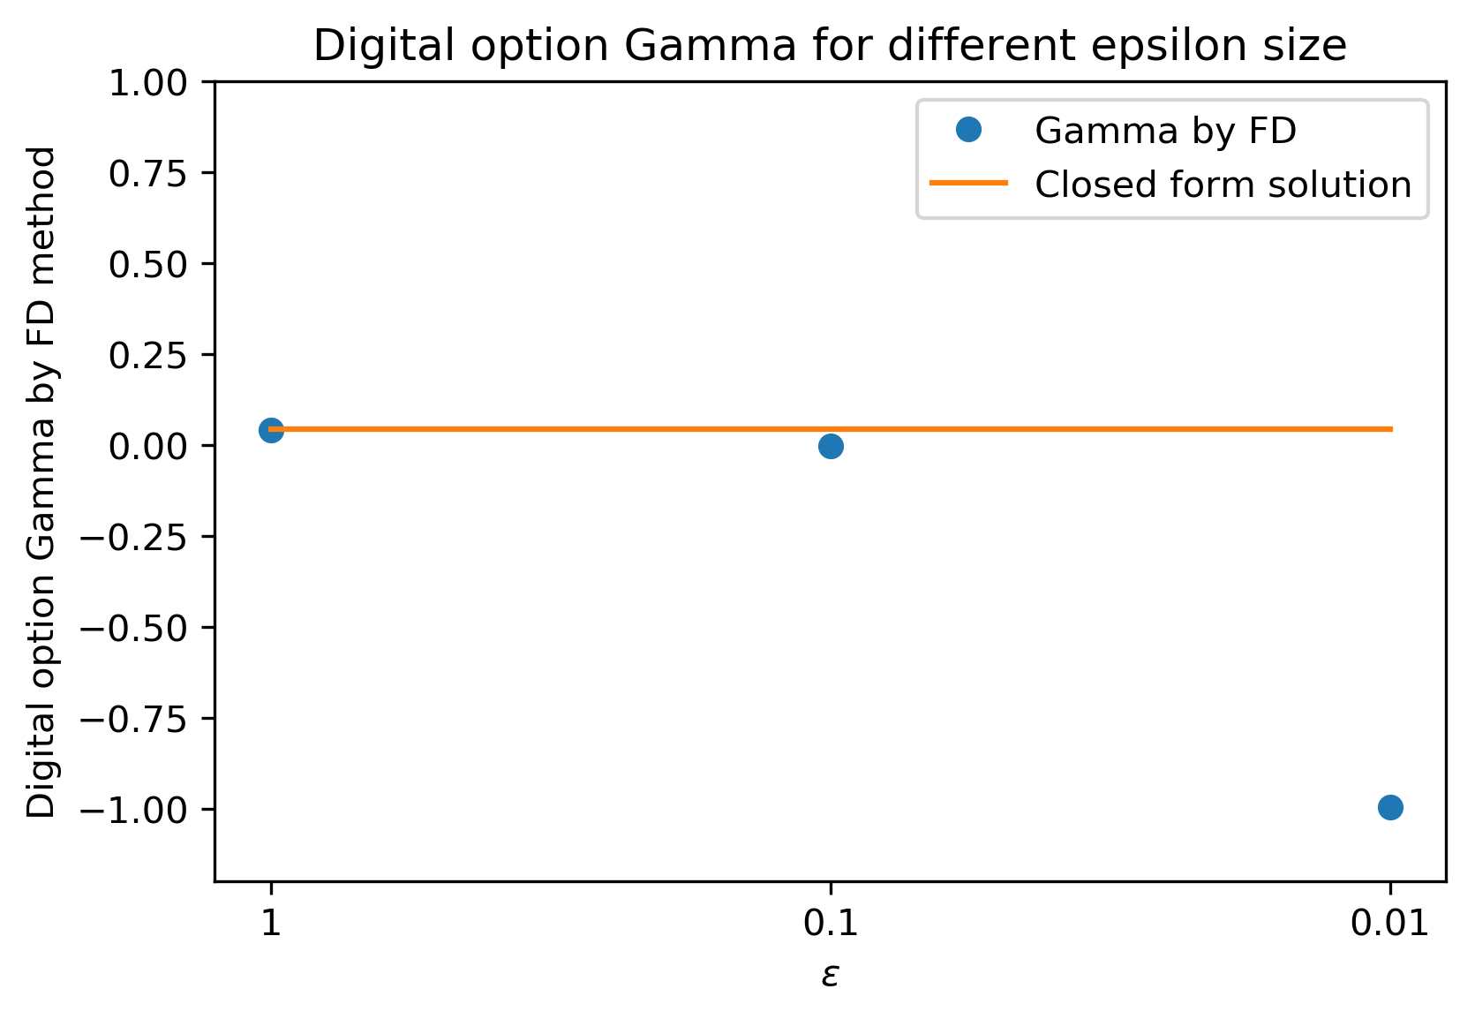
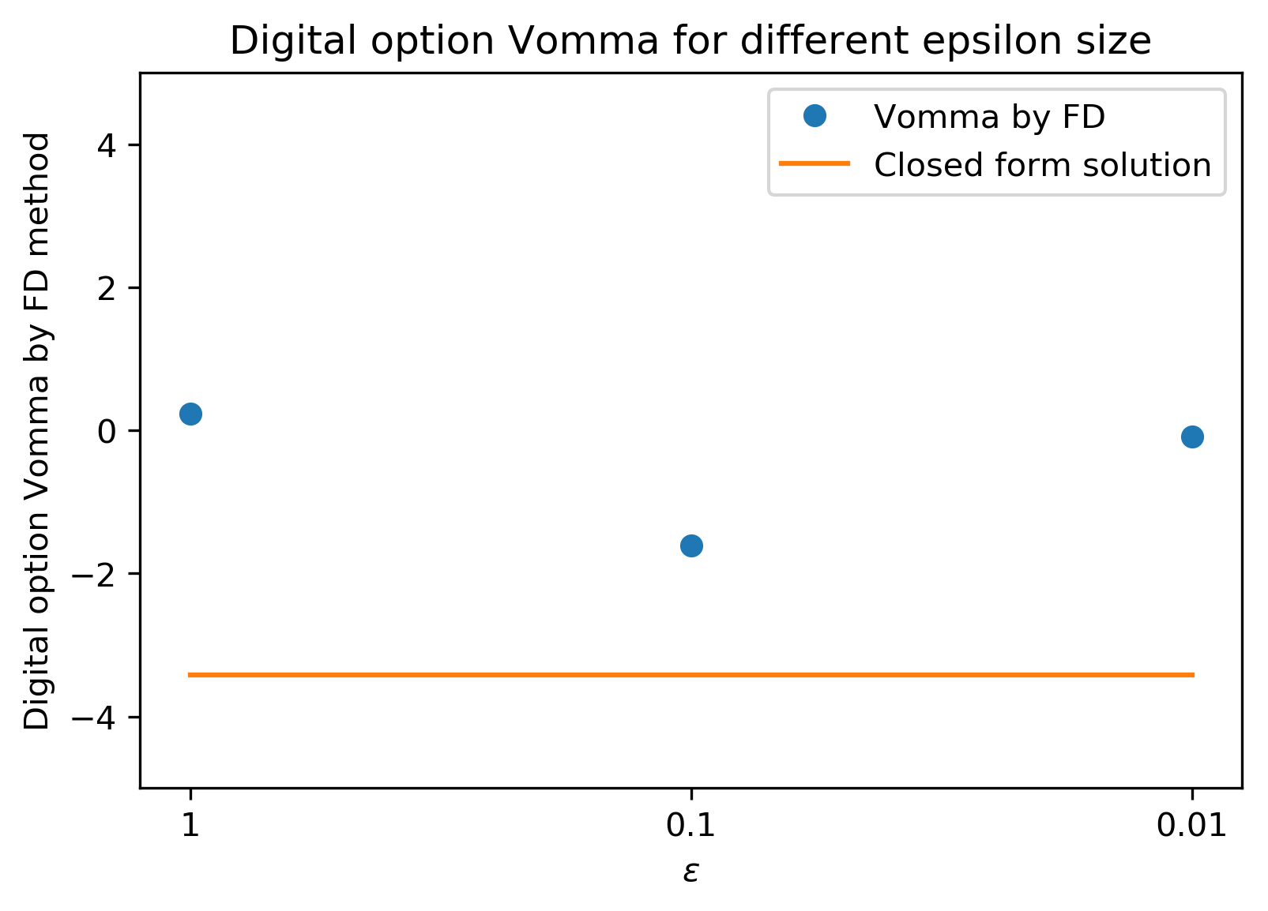
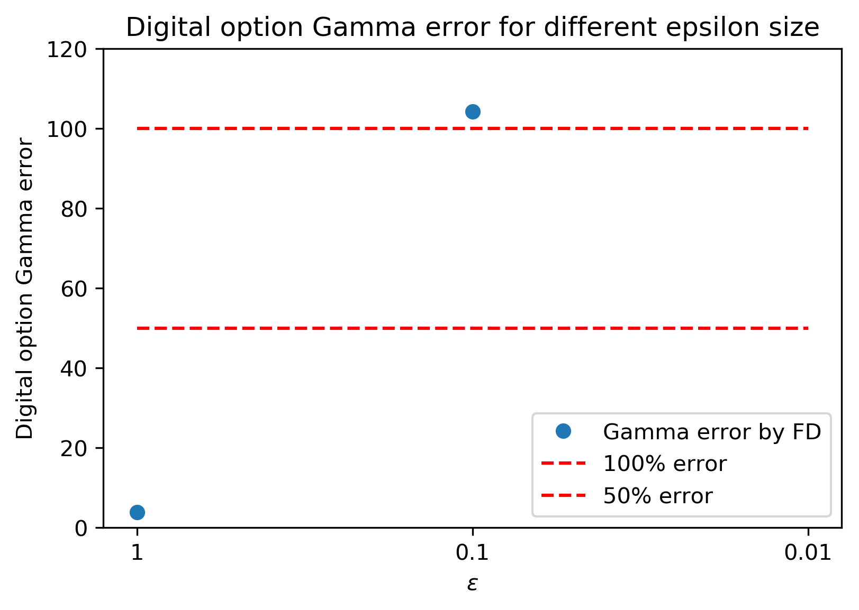
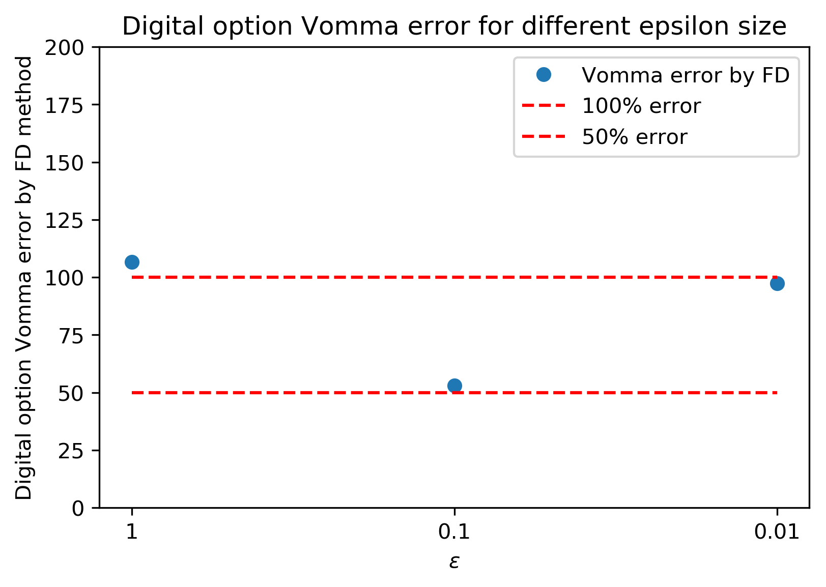
Gamma Vomma

Slide 27
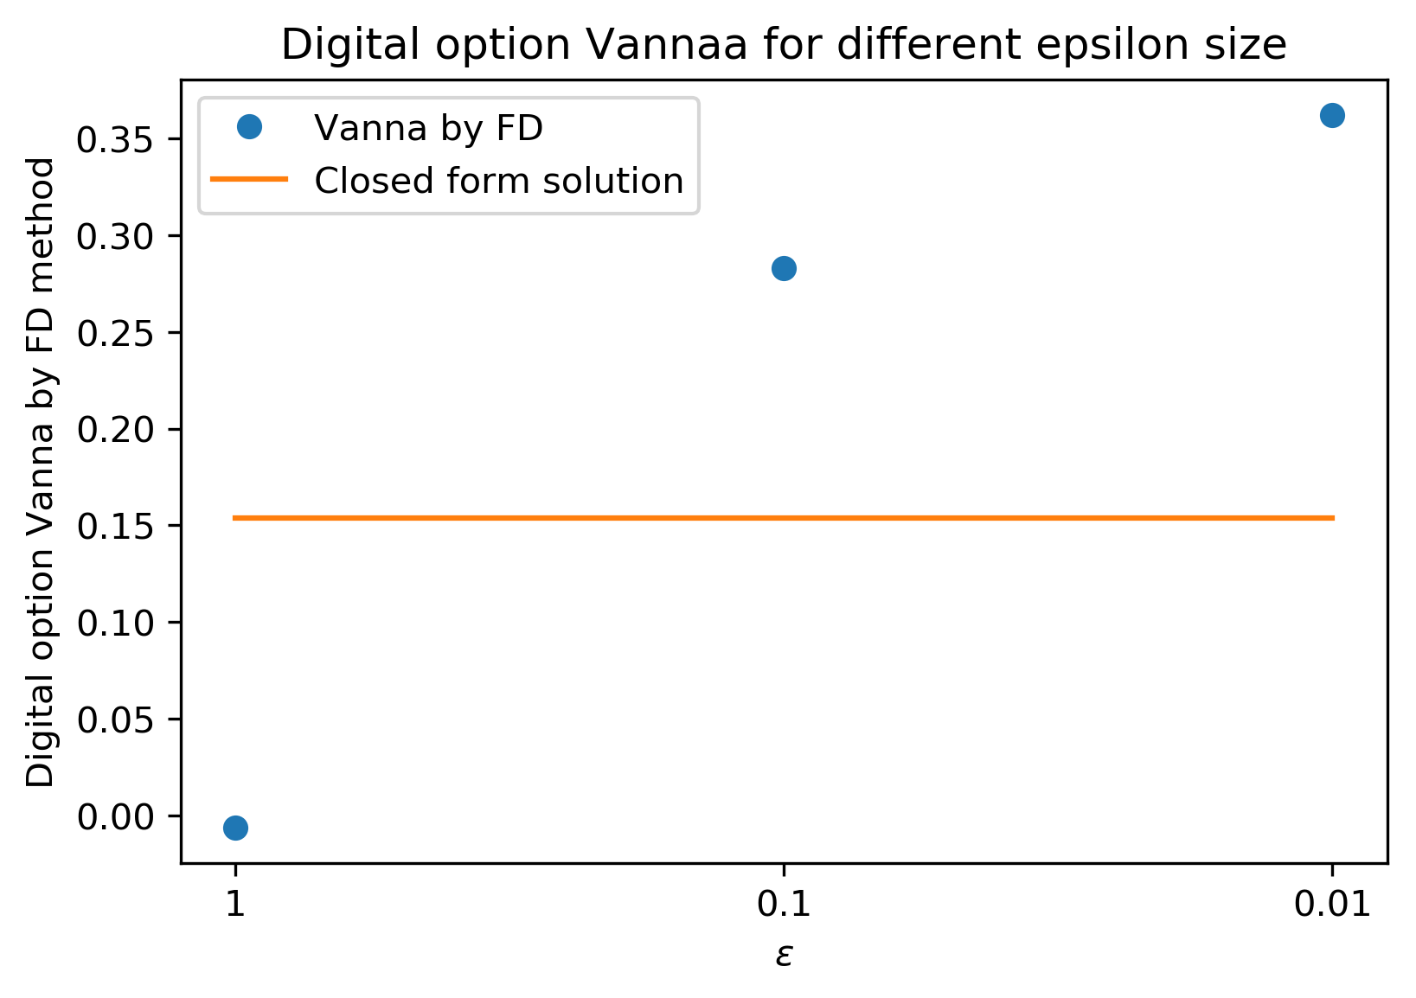
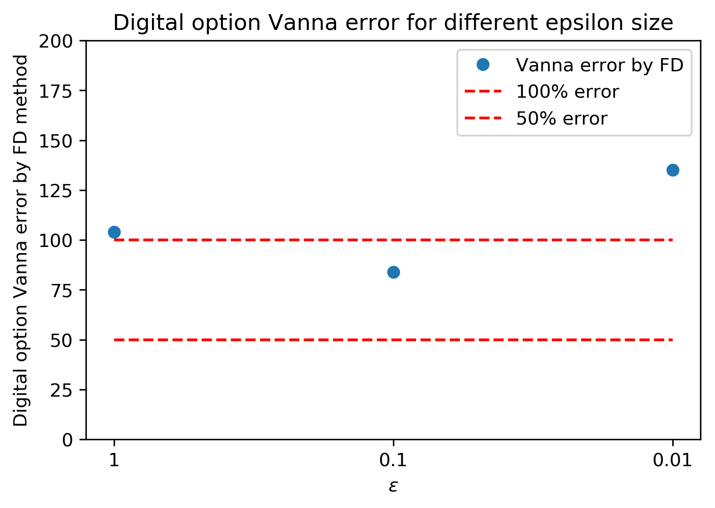
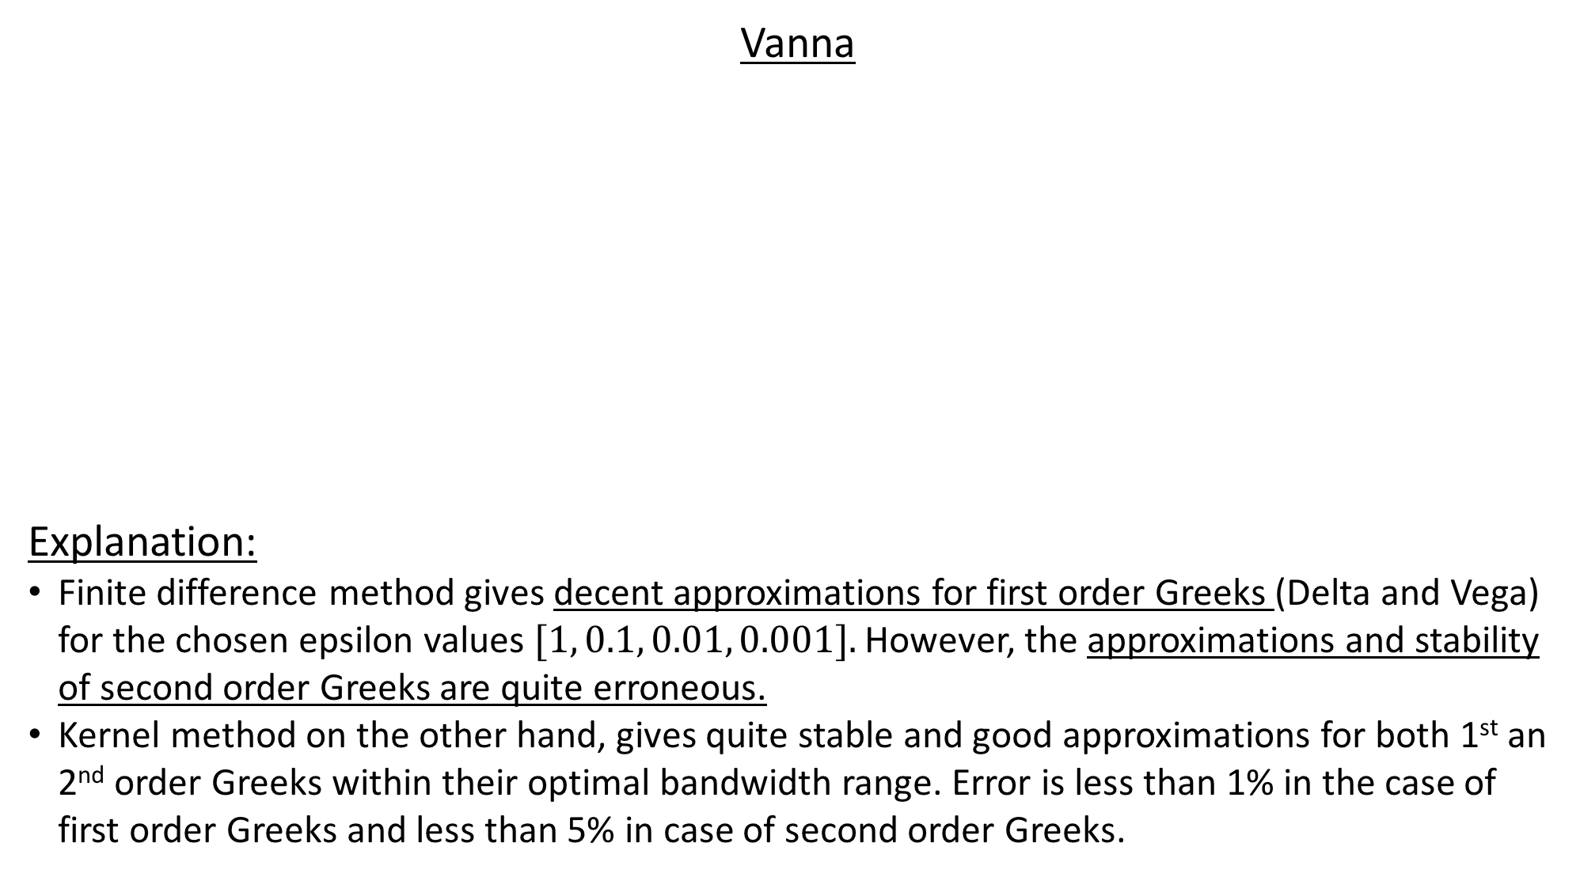
Vanna
Explanation:
Finite difference method gives decent approximations for first order Greeks (Delta and Vega) for the chosen epsilon values $[1, 0.1, 0.01, 0.001].$ However, the approximations and stability of second order Greeks are quite erroneous.
Kernel method on the other hand, gives quite stable and good approximations for both 1st an 2nd order Greeks within their optimal bandwidth range. Error is less than 1% in the case of first order Greeks and less than 5% in case of second order Greeks.

Slide 28
Conclusion
Our findings show that finite support Kernels are much more stable and give better approximations of the Greeks, when compared to infinite support Kernels.
Infinite support Kernels reach their optimal bandwidth range before finite support Kernels.
Kernel technique shows robustness as the numerical results were quite consistent under changed parameters.
Lastly, comparing our results with that of finite difference method showed that although finite difference method gave good approximations for first order Greeks, second order Greeks were quite erroneous.
Kernel method, on the other hand, gave very good approximations and were much more stable than their counterpart for all the Greeks with error less than 1% in the case of first order Greeks and less than 5% in case of second order Greeks.

Slide 29
Thank you for your attention.
Now we are happy to answer any questions you might have.

